Slide 1
UROGENITAL TRIANGLE
DR OSO

Slide 2
OUTLINE
Introduction
Boundaries
Layers and contents
  Superficial perineal pouch
  Deep perineal pouch
  Perineal membrane
Blood supply
Nerve supply
Clinical importance

Slide 3
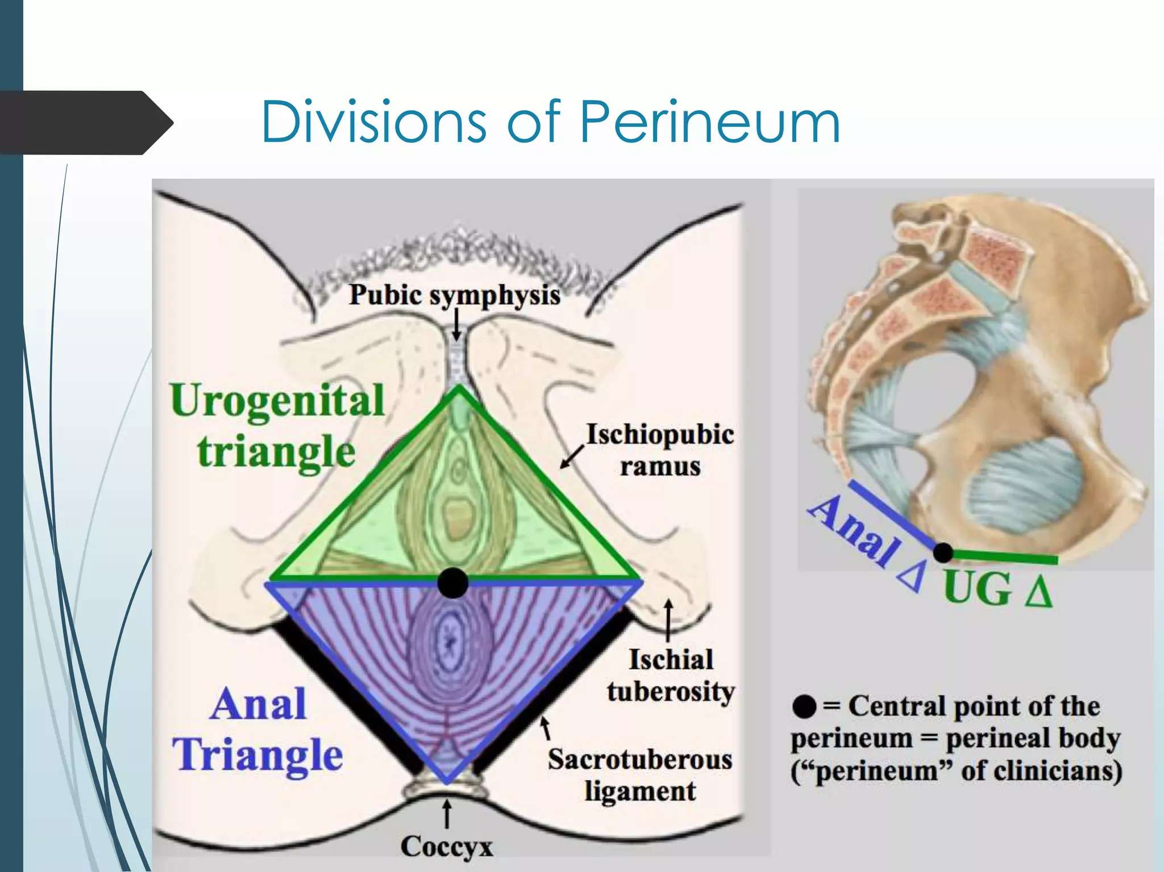

Slide 4
Introduction
The urogenital triangle of the perineum is the anterior half of the perineum
It’s concerned mainly with urinary and reproductive function

Slide 5
Boundaries
Anterior: inferior border of pubic symphysis
Lateral: right and left ischiopupic rami
Posterior: imaginary line joining the ischial tuberosities
Roof: perineal membrane
Floor: skin and superficial fascia of the perineum

Slide 6
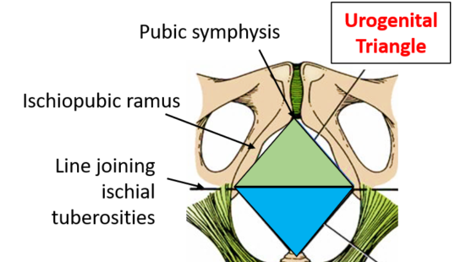

Slide 7
Layers and Contents
Layers
Skin
Superficial fascia
Superficial perineal pouch
Perineal membrane
Deep perineal pouch

Slide 8
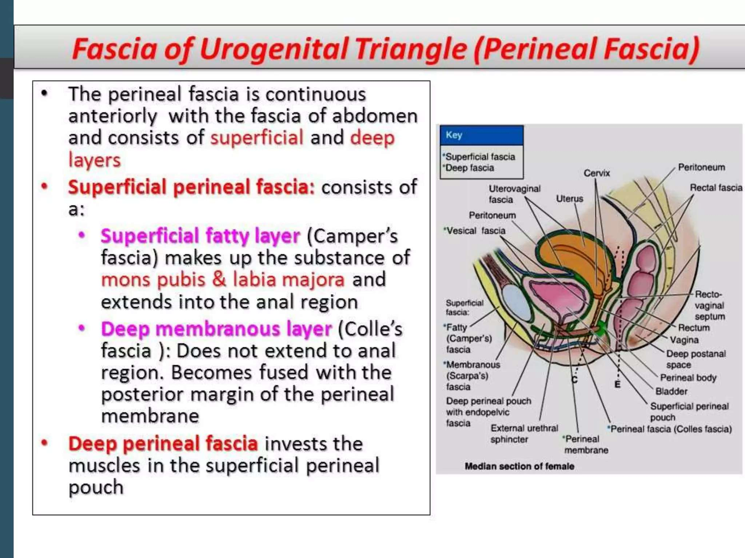

Slide 9
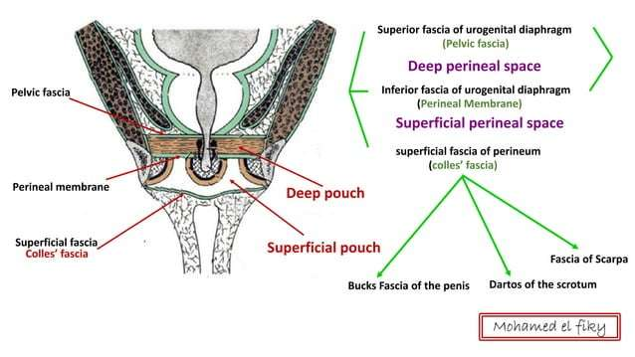

Slide 10
Superficial fascia
Fatty layer (Camper’s fascia)- minimal in the perineum
Membranous layer (Colle’s fascia)
  Continuous with Scarpa’s fascia of the anterior abdominal wall
  Important in extravasation of urine

Slide 11
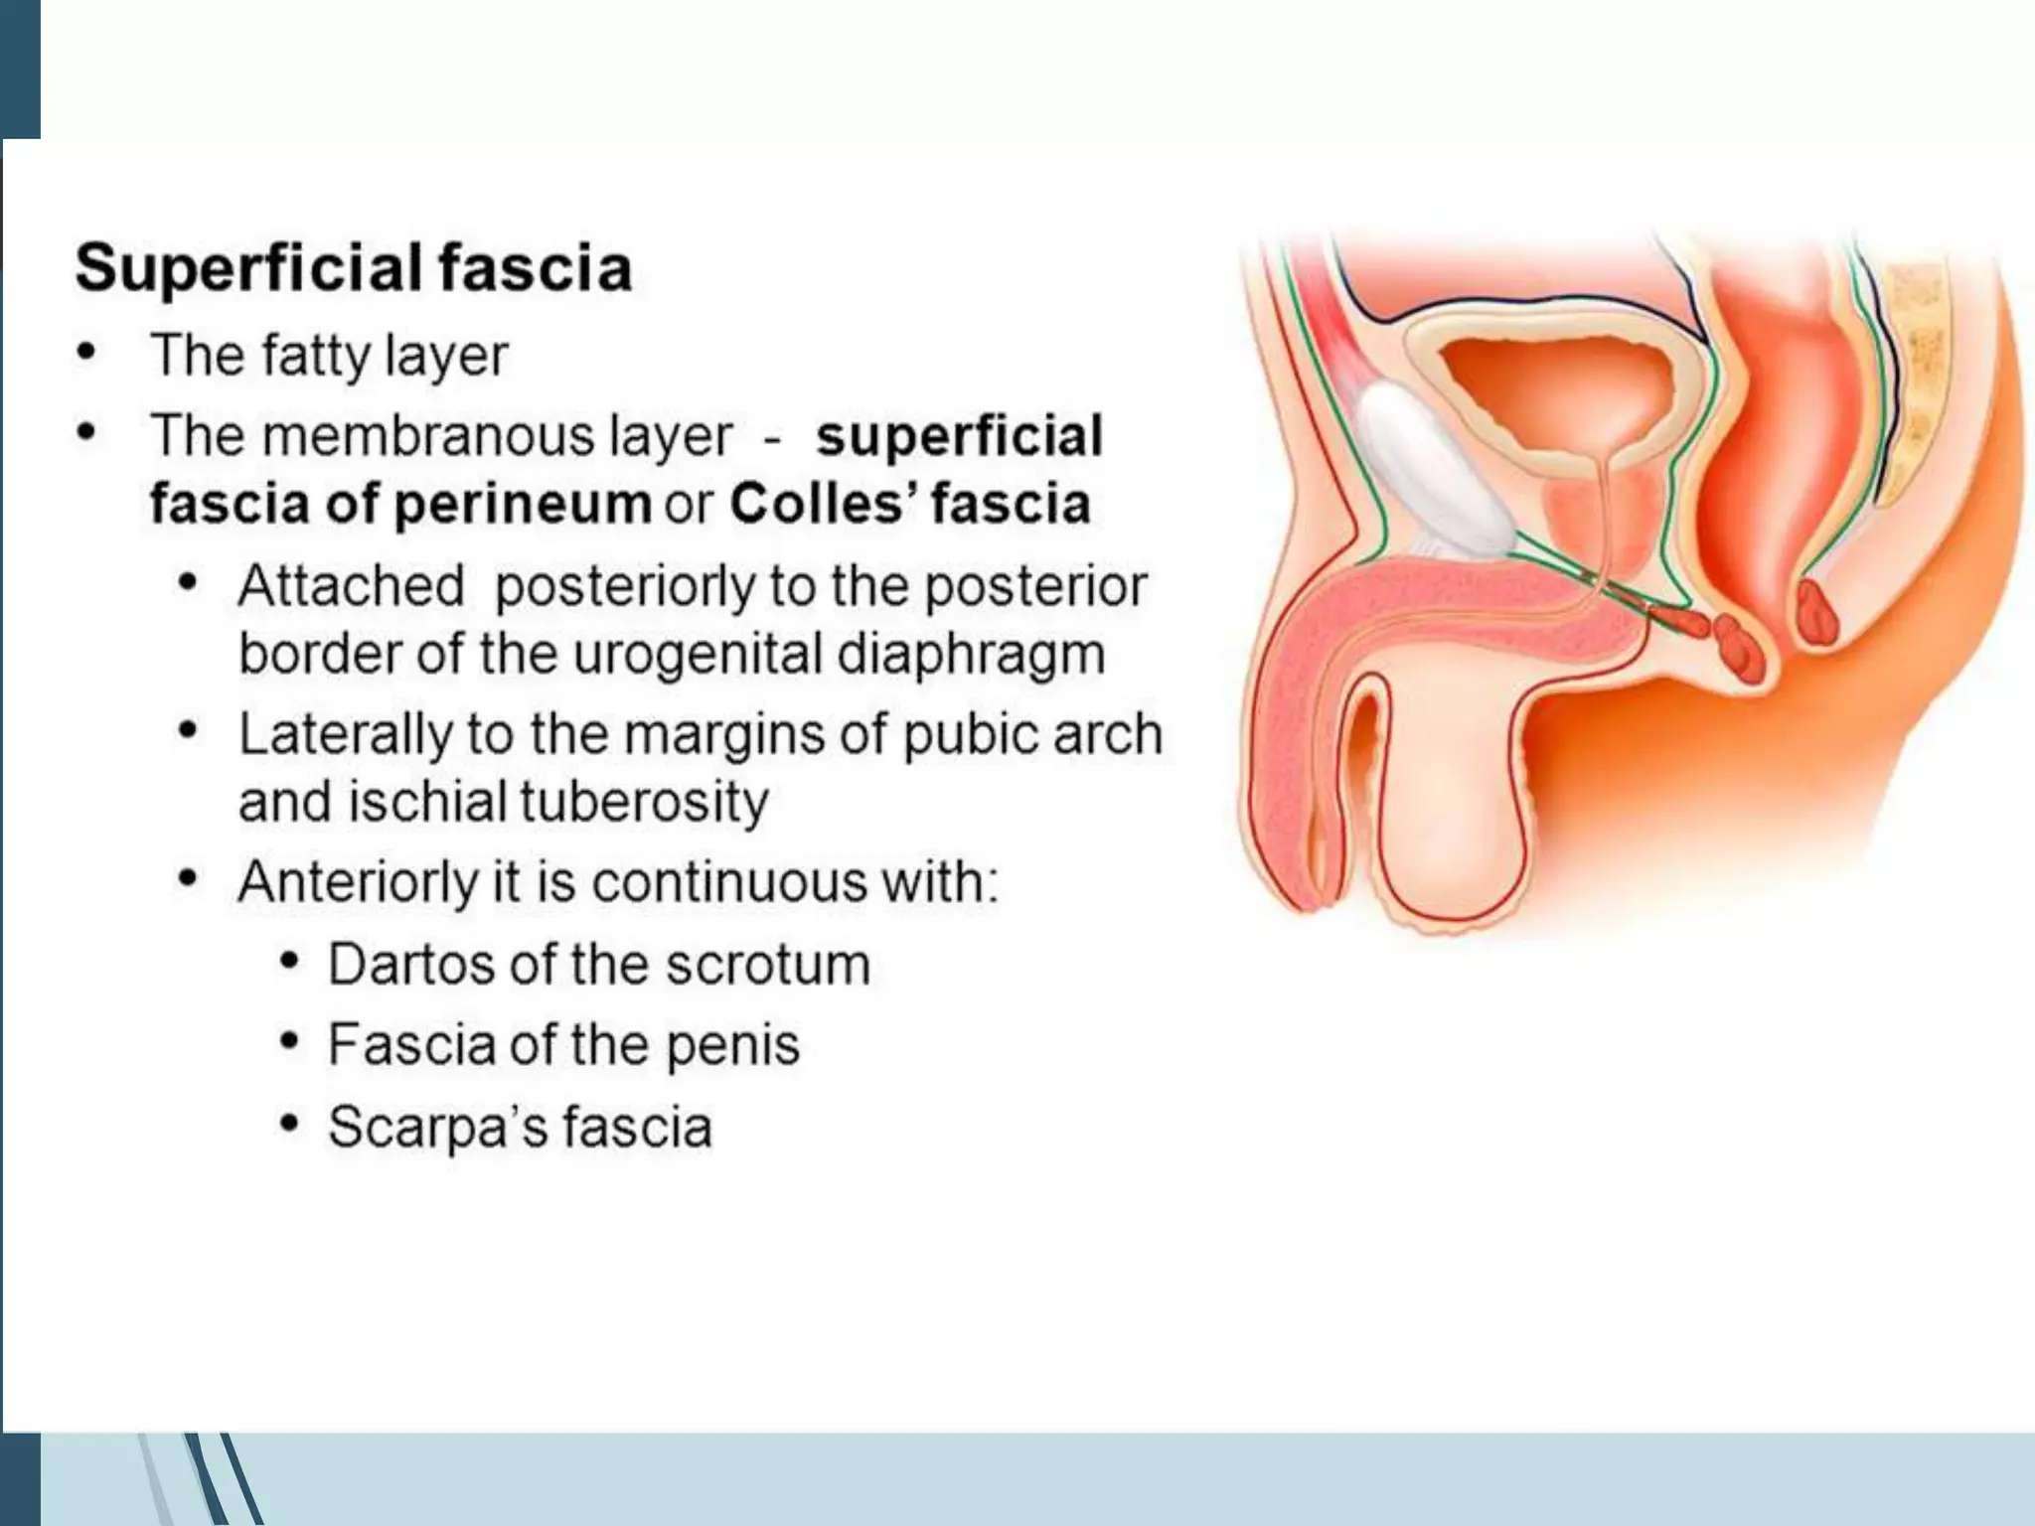

Slide 12
Superficial perineal pouch

Slide 13
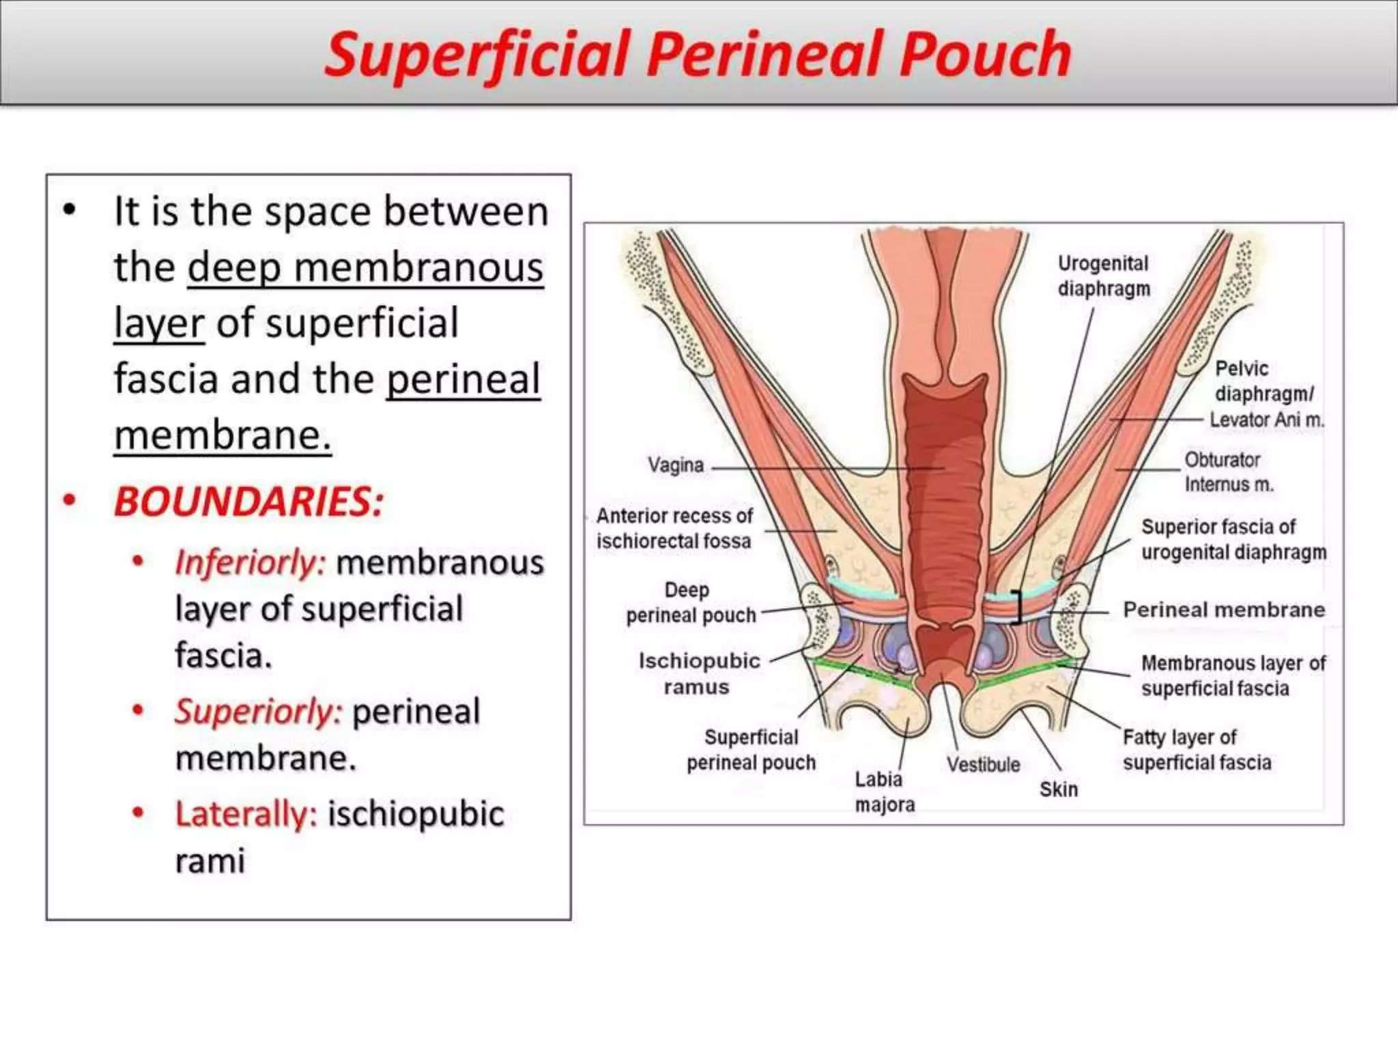

Slide 14
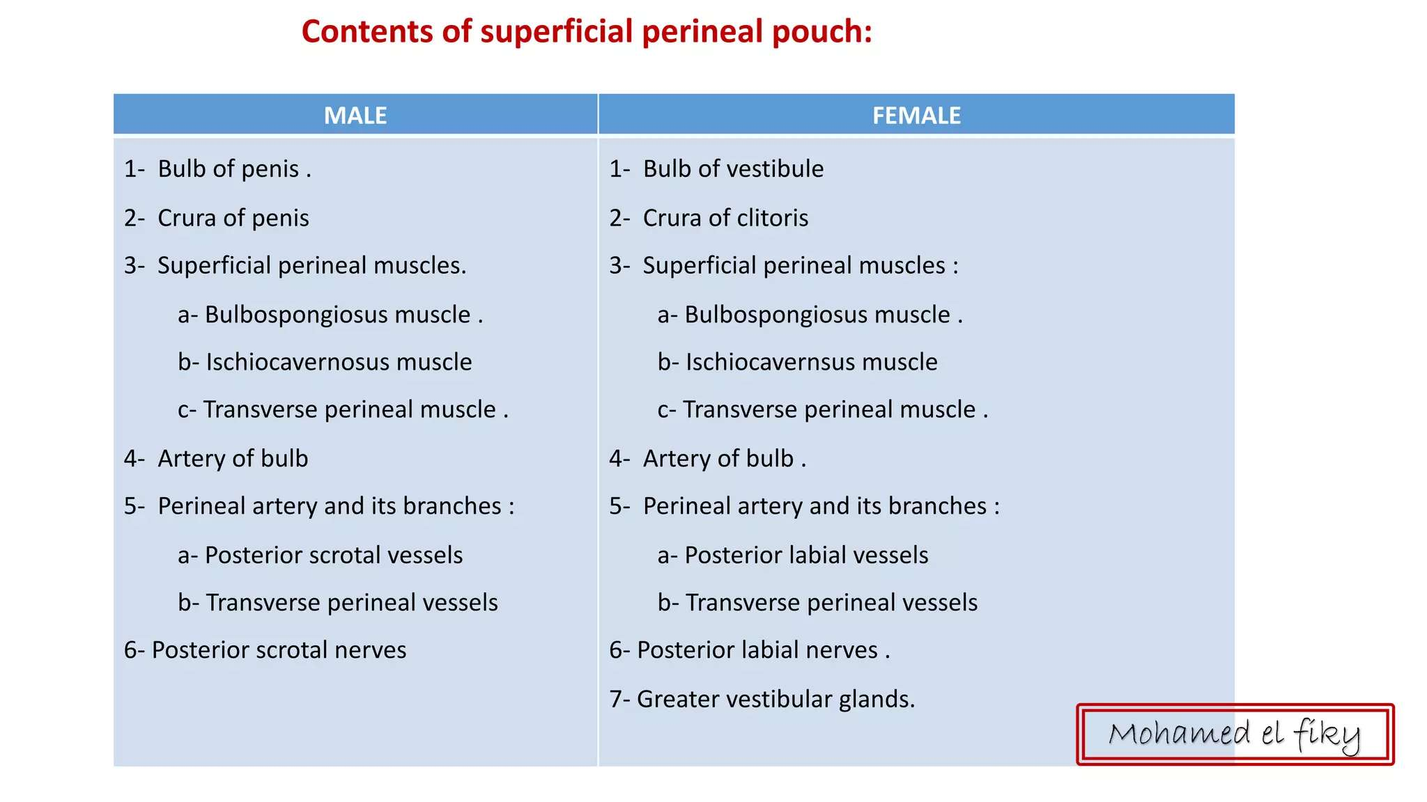

Slide 15
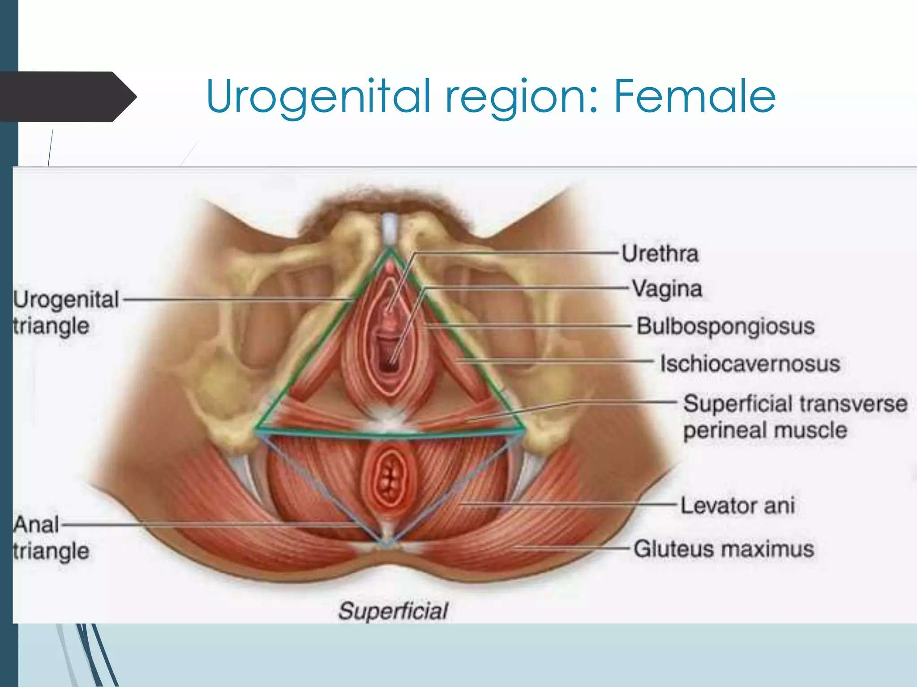

Slide 16
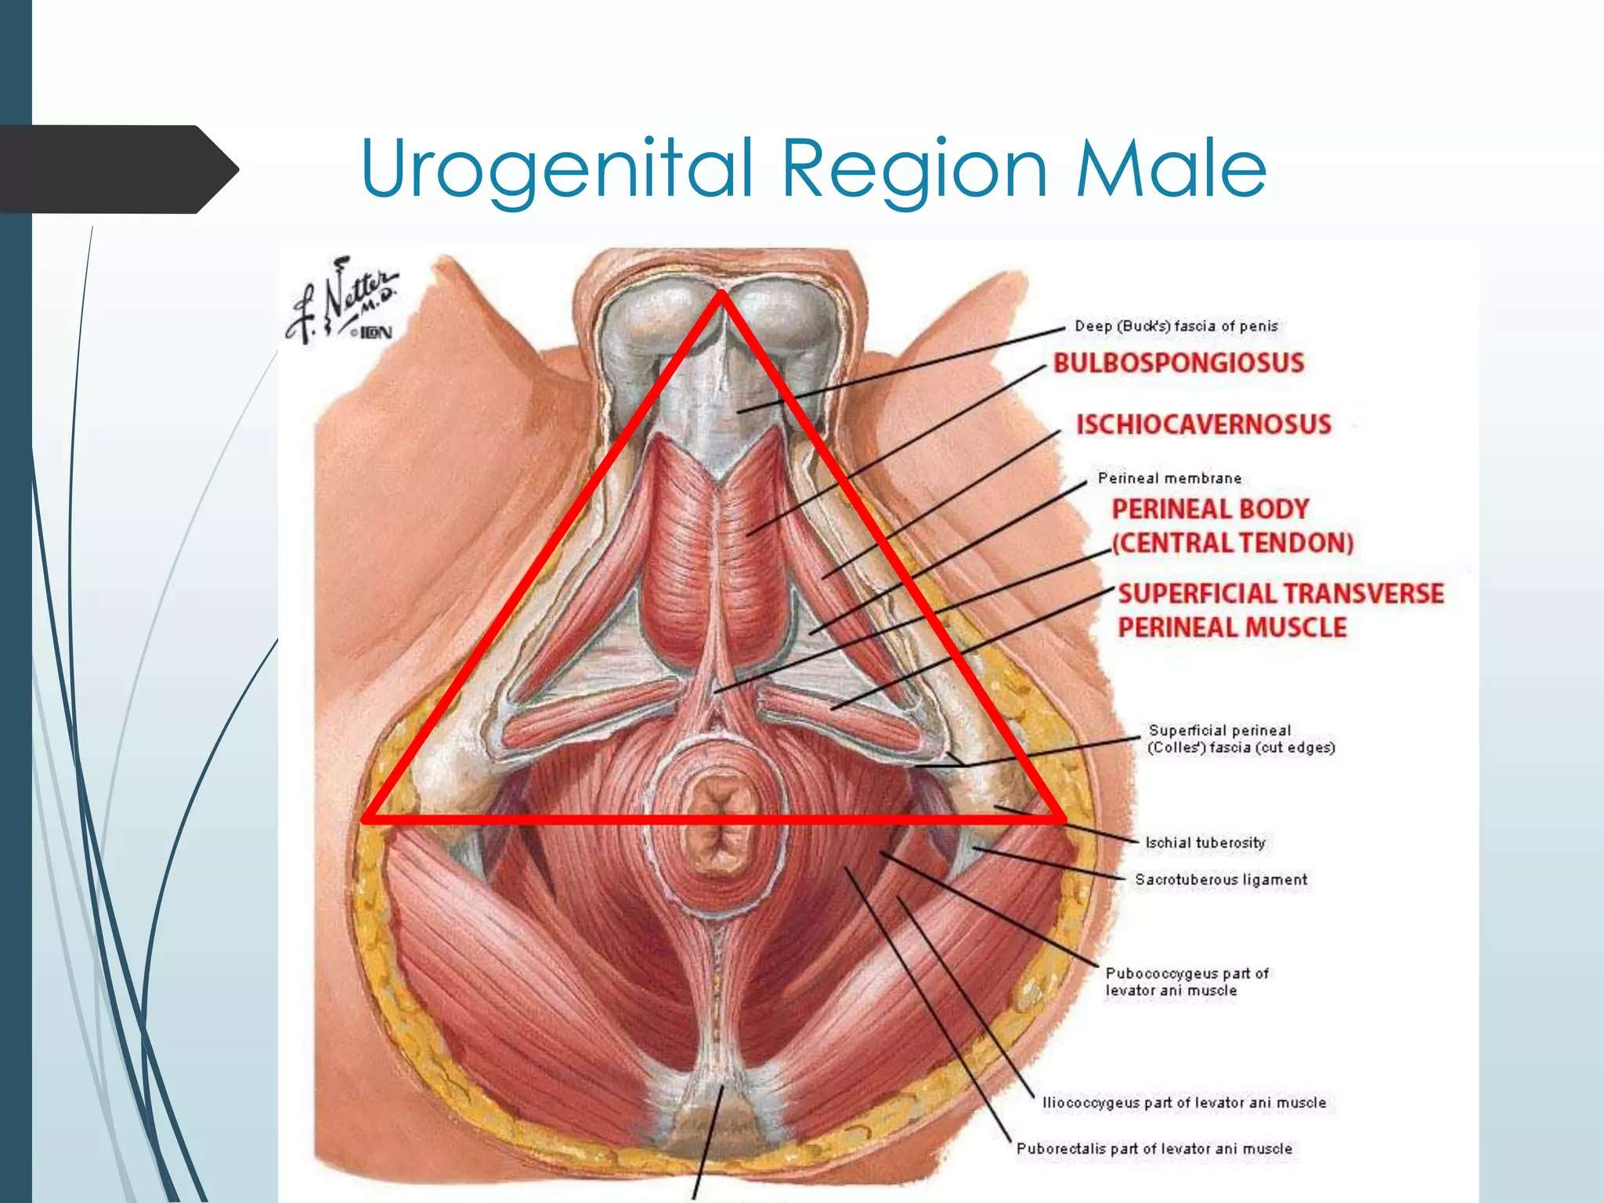

Slide 17
Perineal membrane

Slide 18
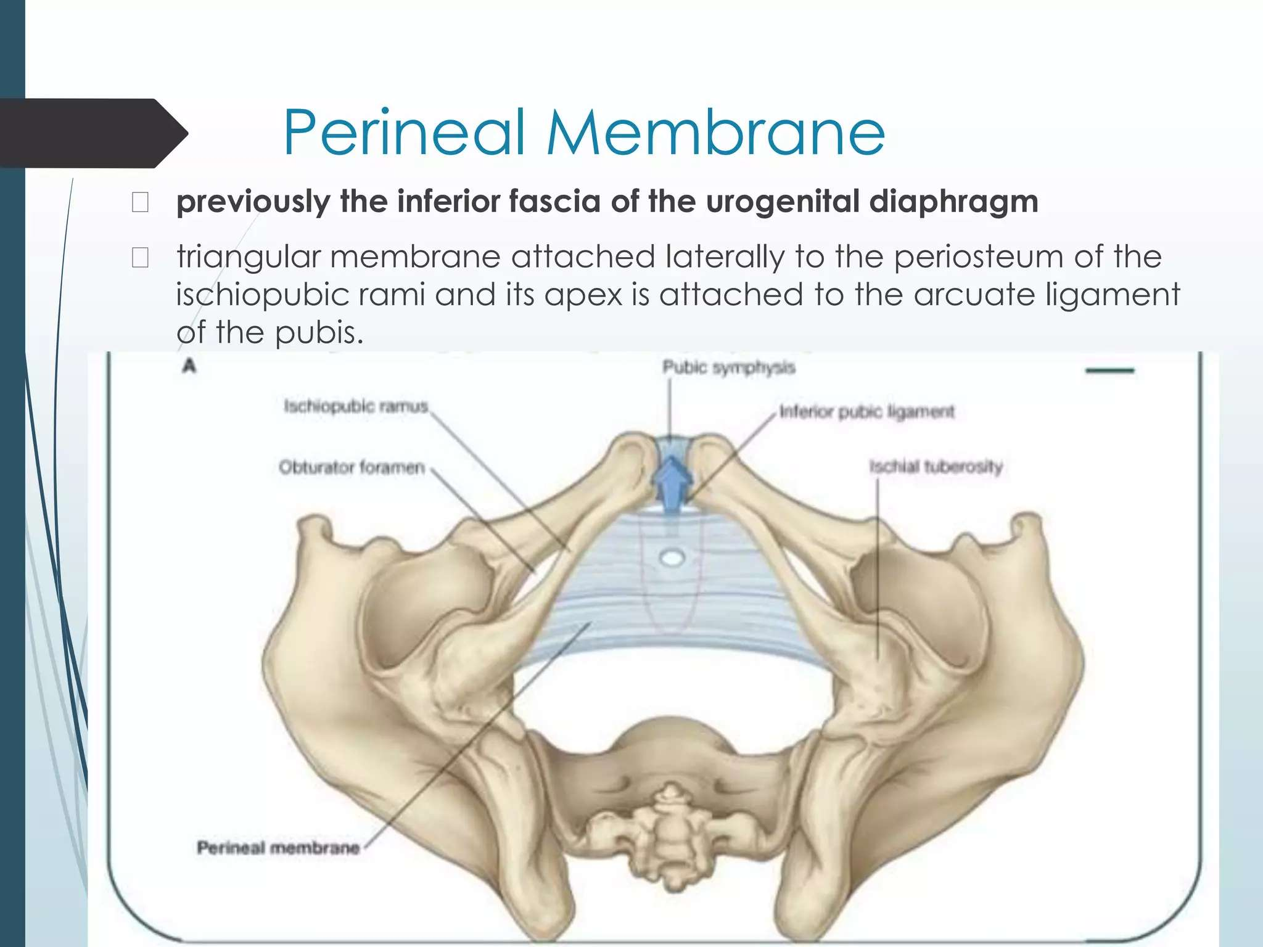

Slide 19
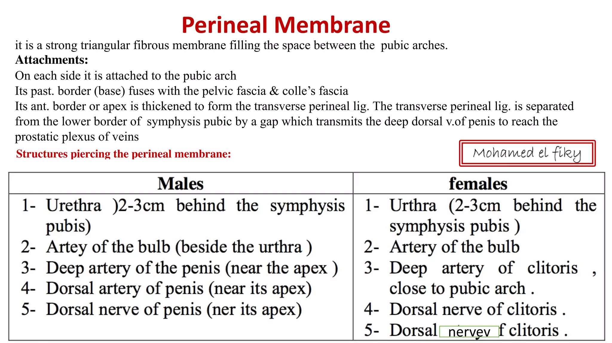

Slide 20
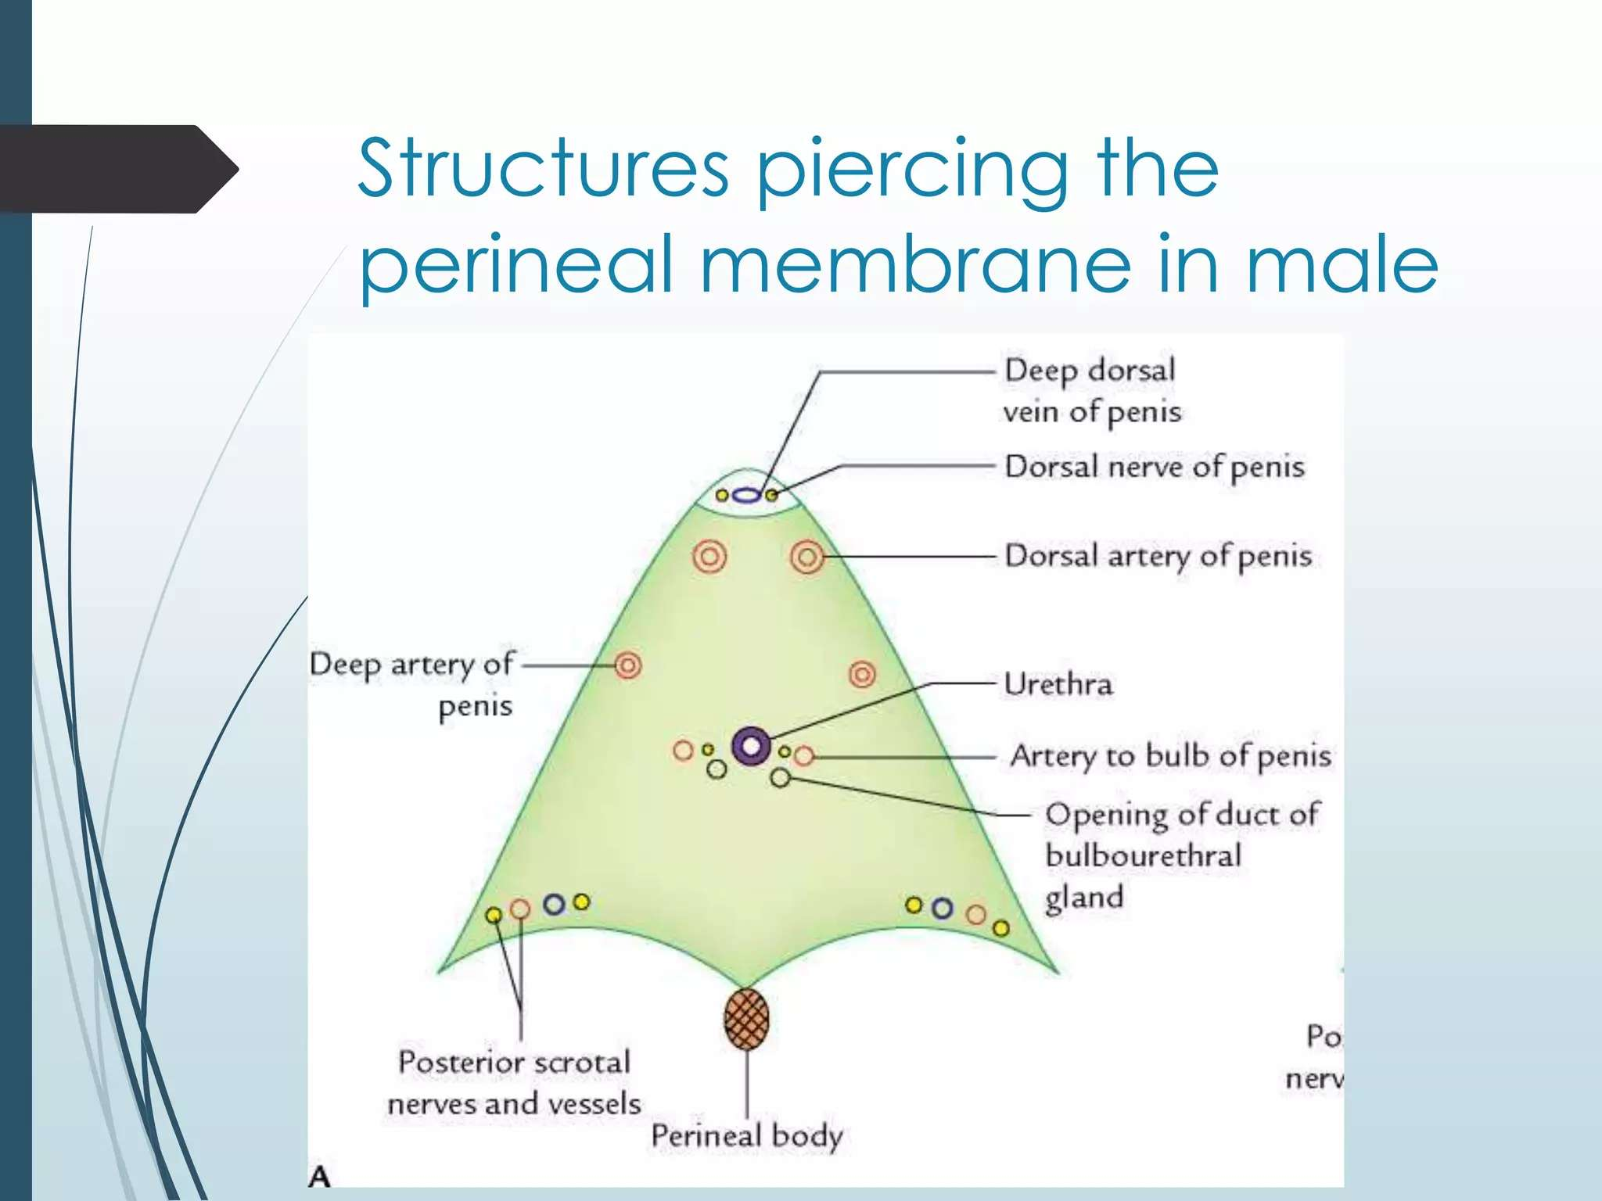

Slide 21
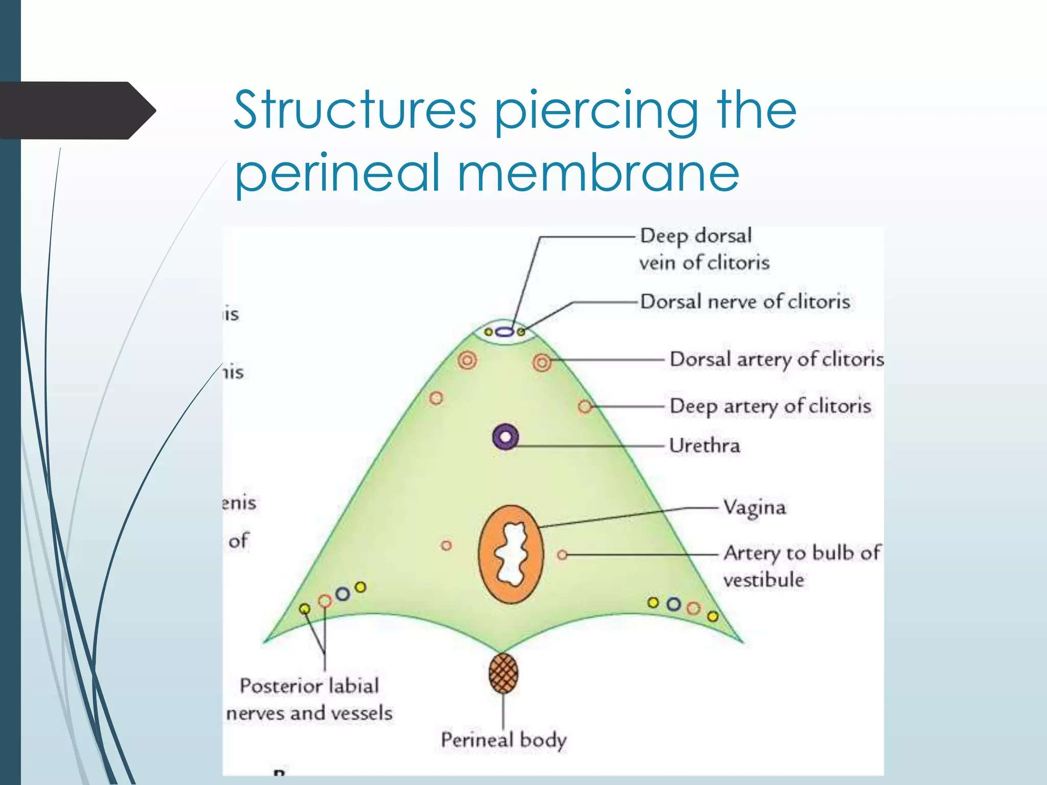

Slide 22
Deep perineal pouch
Bounded by:
Inferiorly: perineal membrane
Superiorly: pelvic diaphragm

Slide 23
Contents of the deep perineal pouch
Male
Female
External urethral sphincter
Membranous urethra
Bulbourethra (Cowpea’s) glands
Deep transverse perineal muscle
Dorsal nerve and vessels of penis
External urethral sphincter
Compressor urethra
urethrovagina;l sphincter
Deep transverse perineal muscle

Slide 24
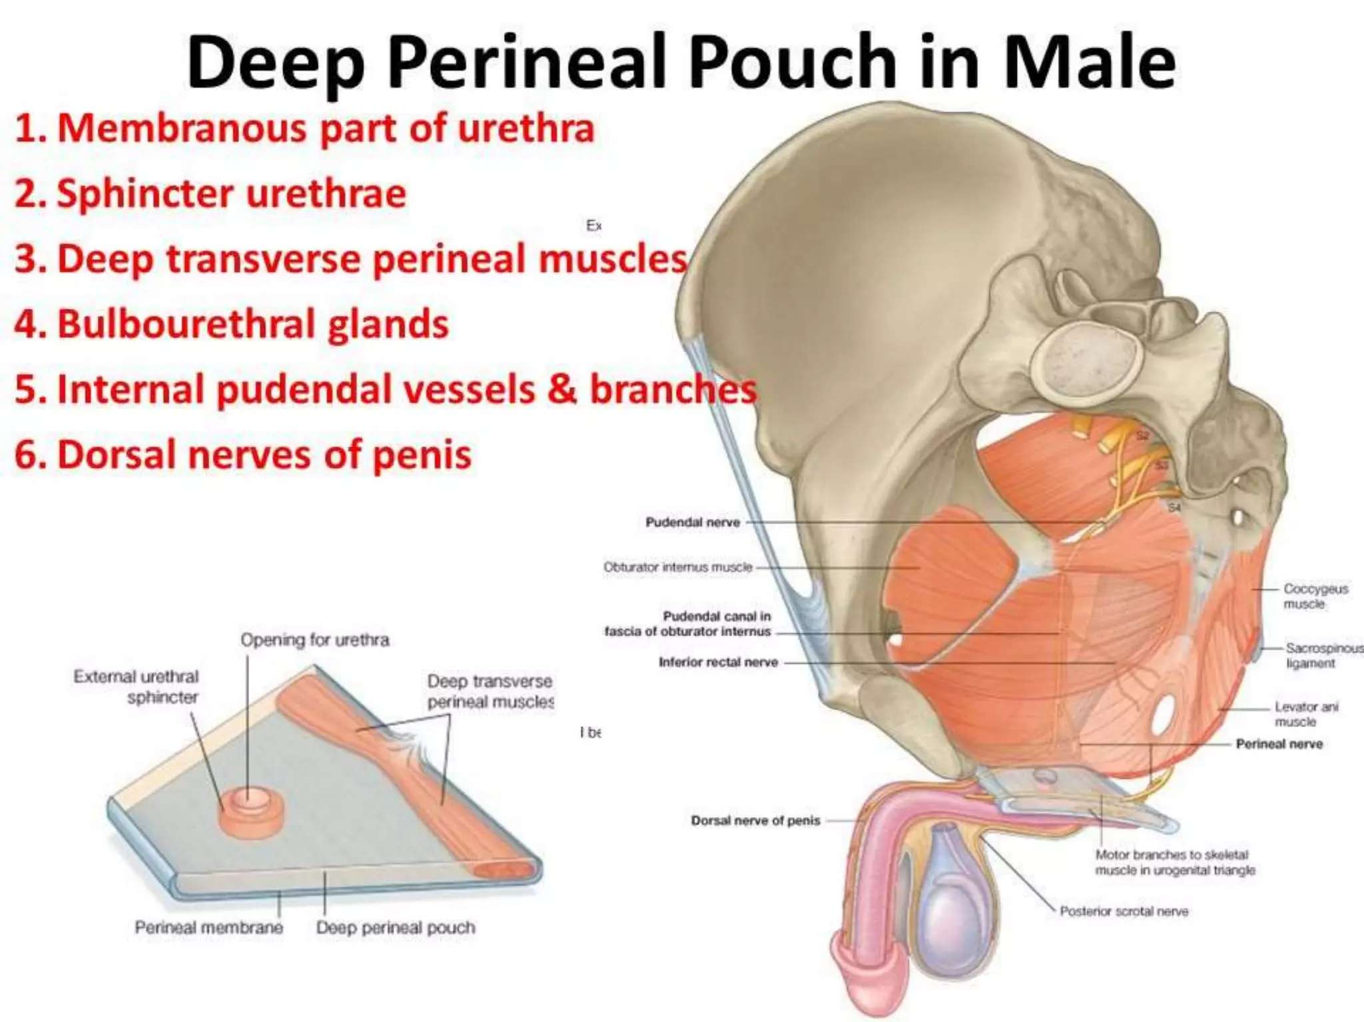

Slide 25
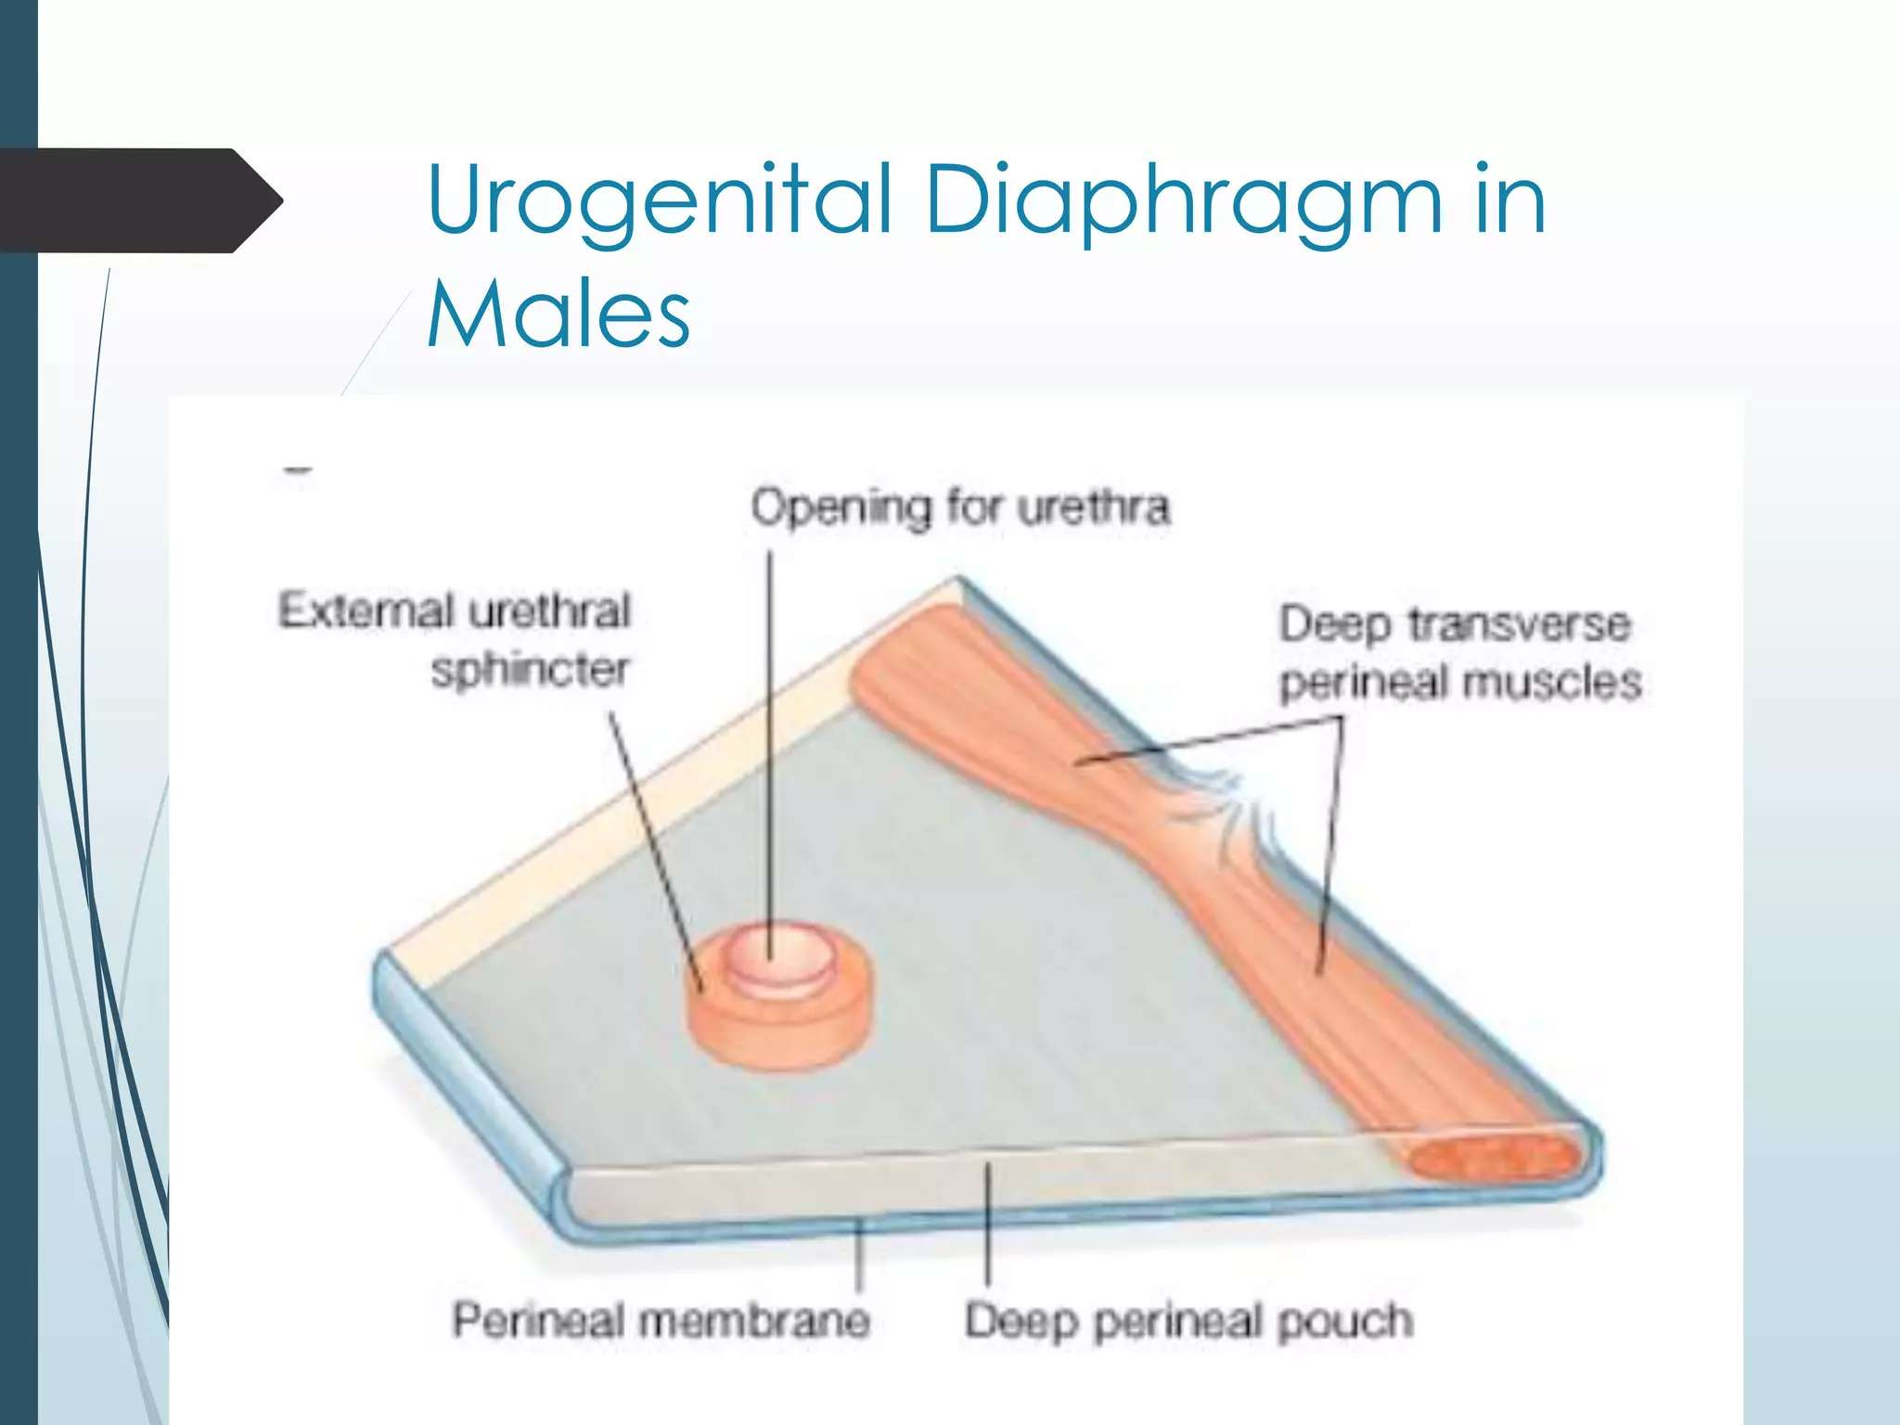

Slide 26
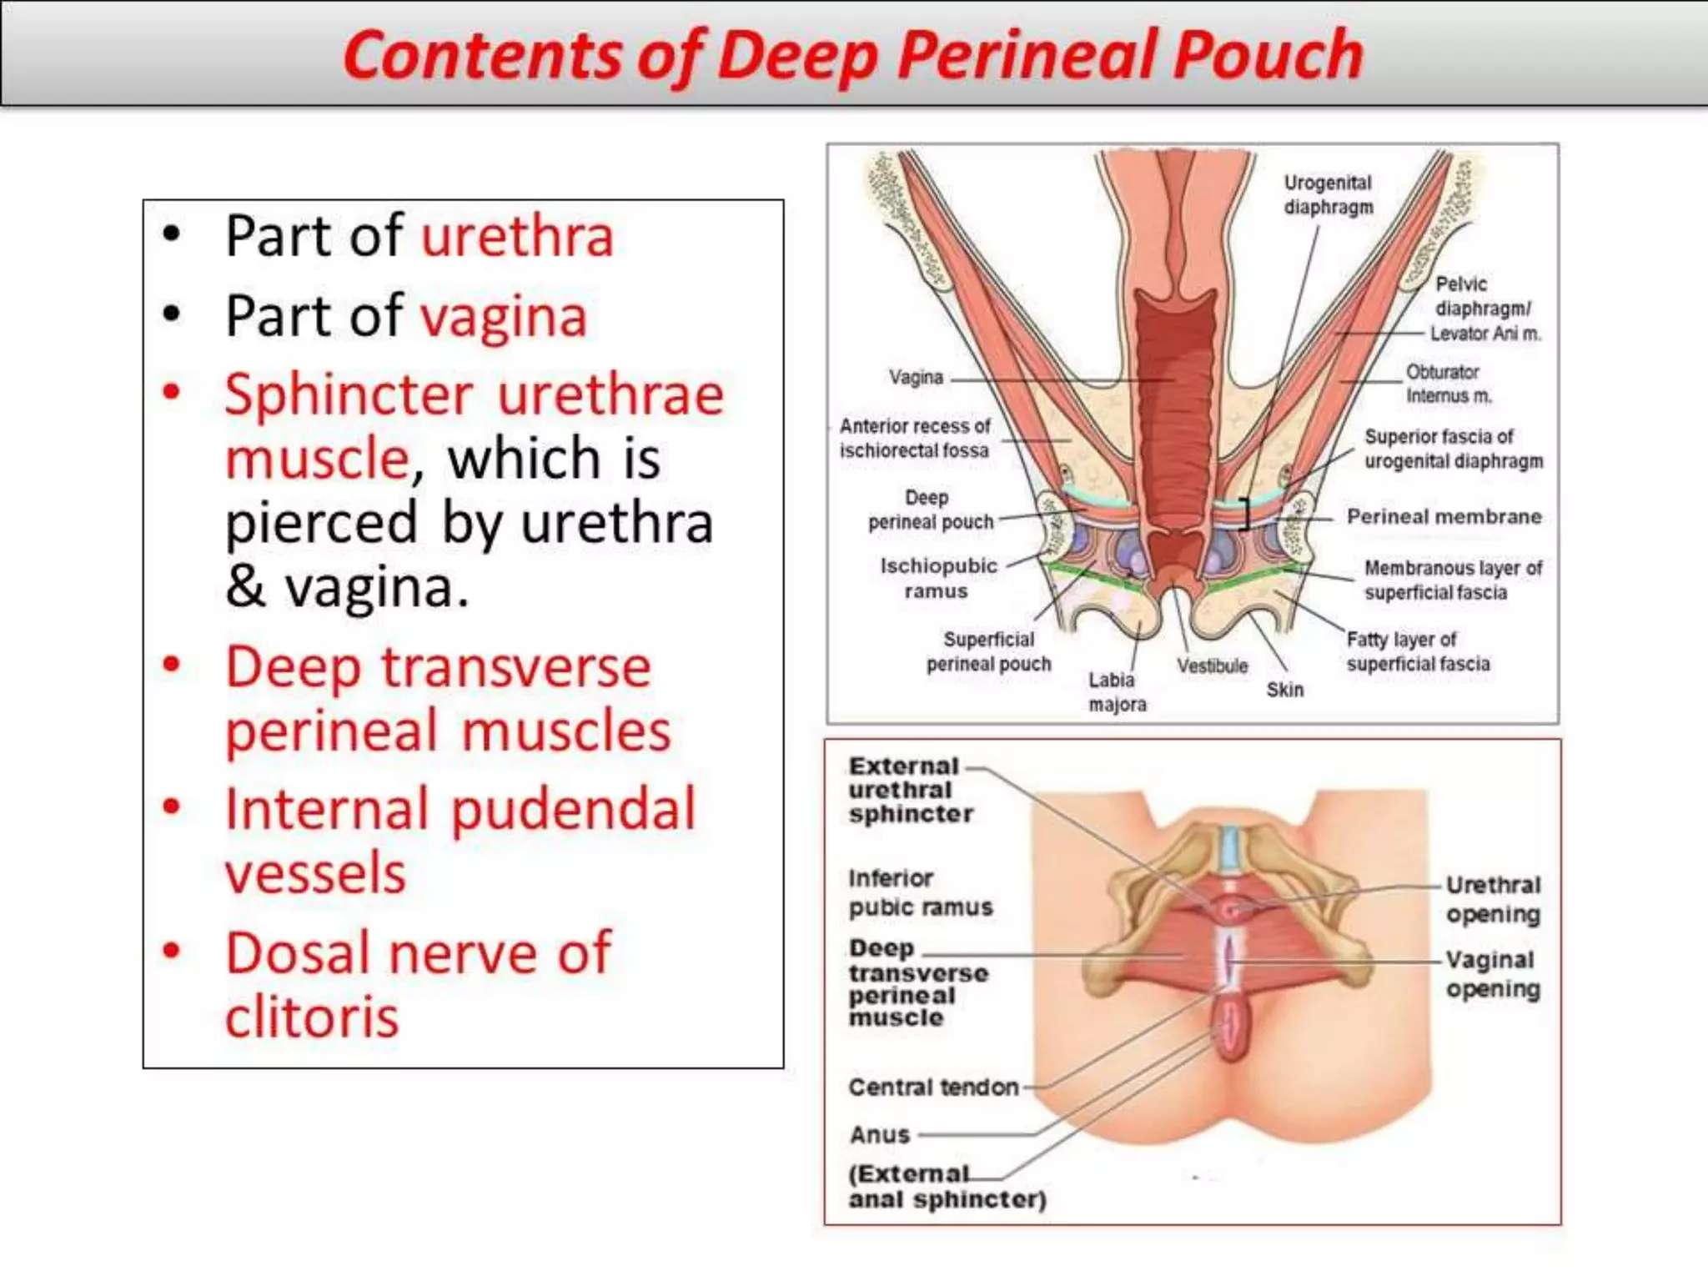

Slide 27
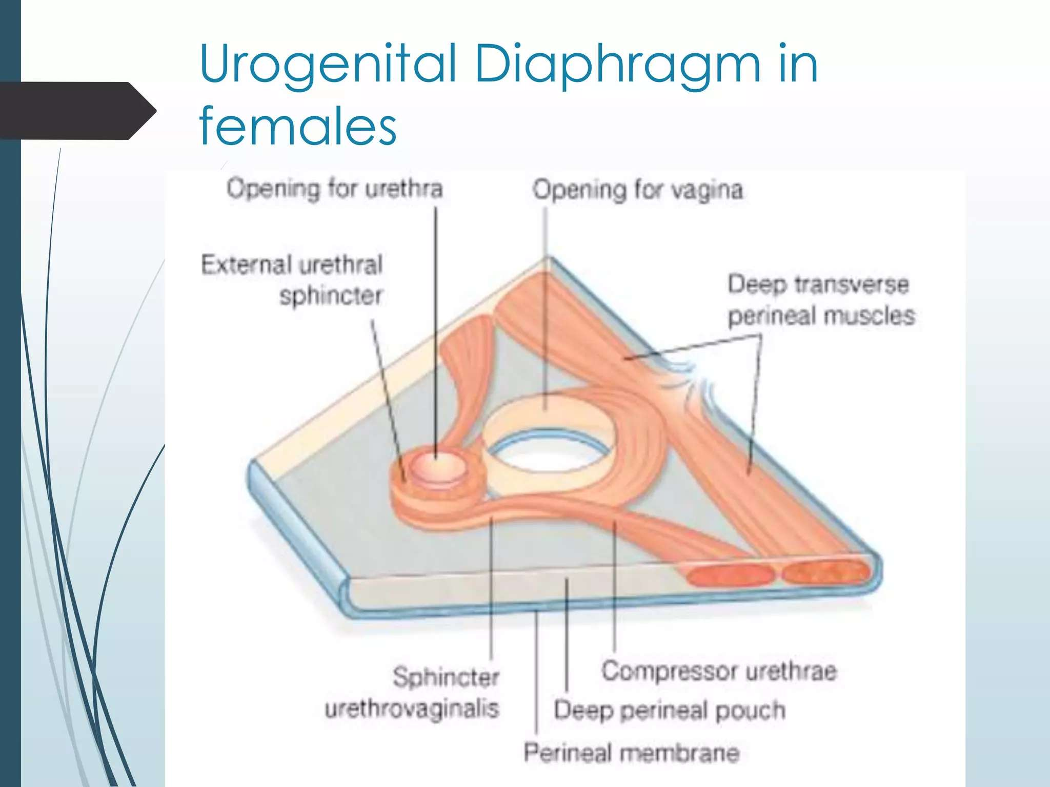

Slide 28
Neurovascular supply
Nerve: Pudendal nerve
Artery: Internal pudendal artery
Vein: Internal pudendal vein

Slide 29
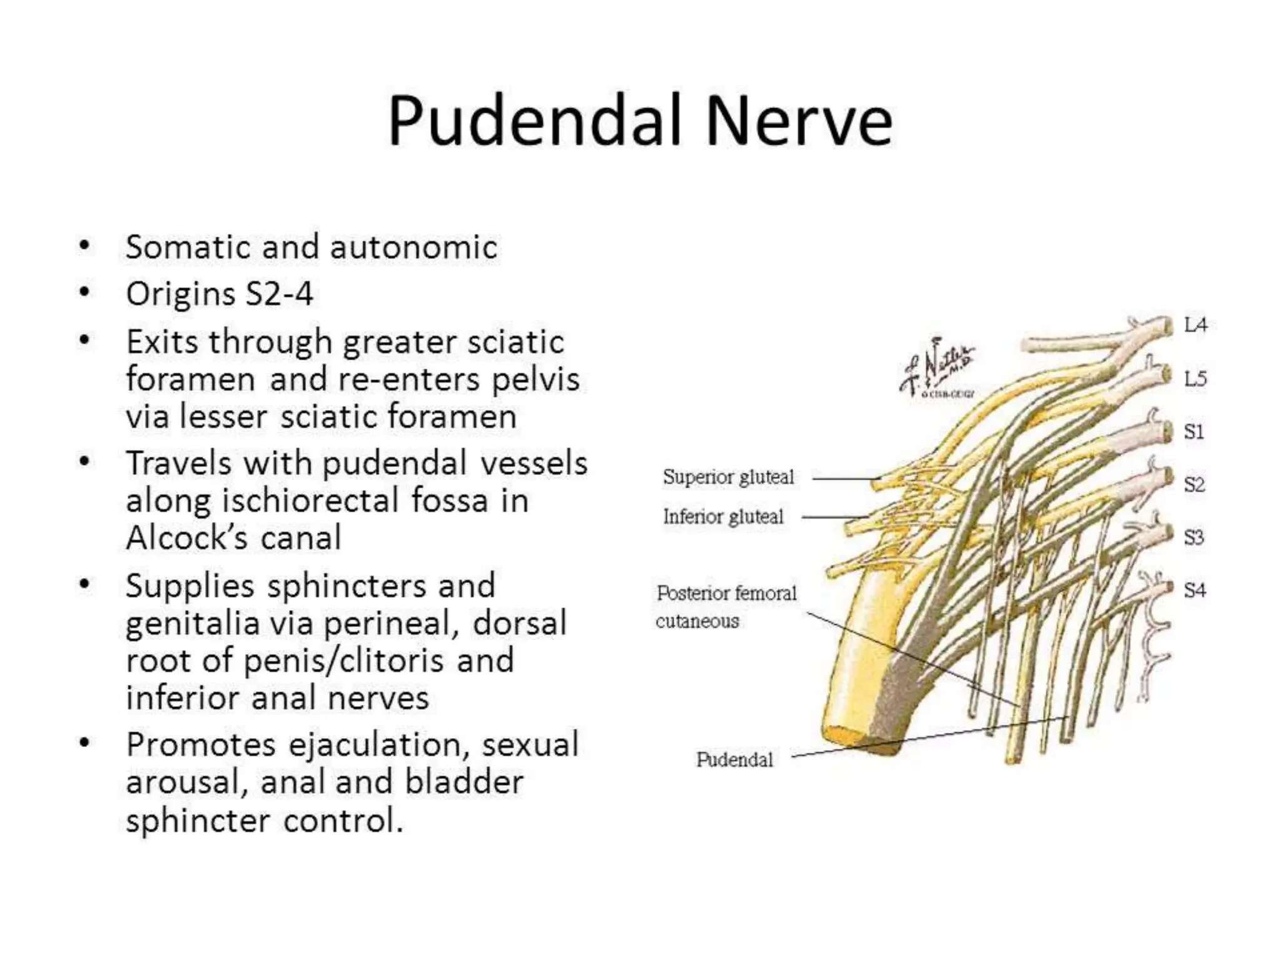

Slide 30
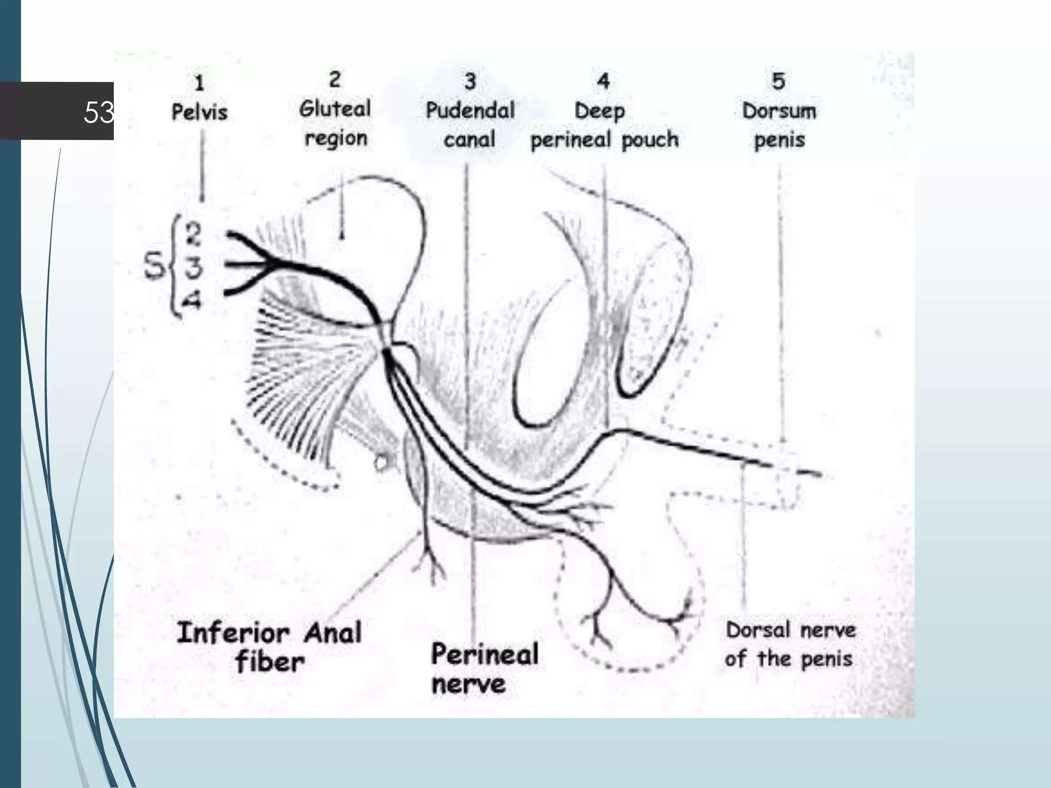

Slide 31
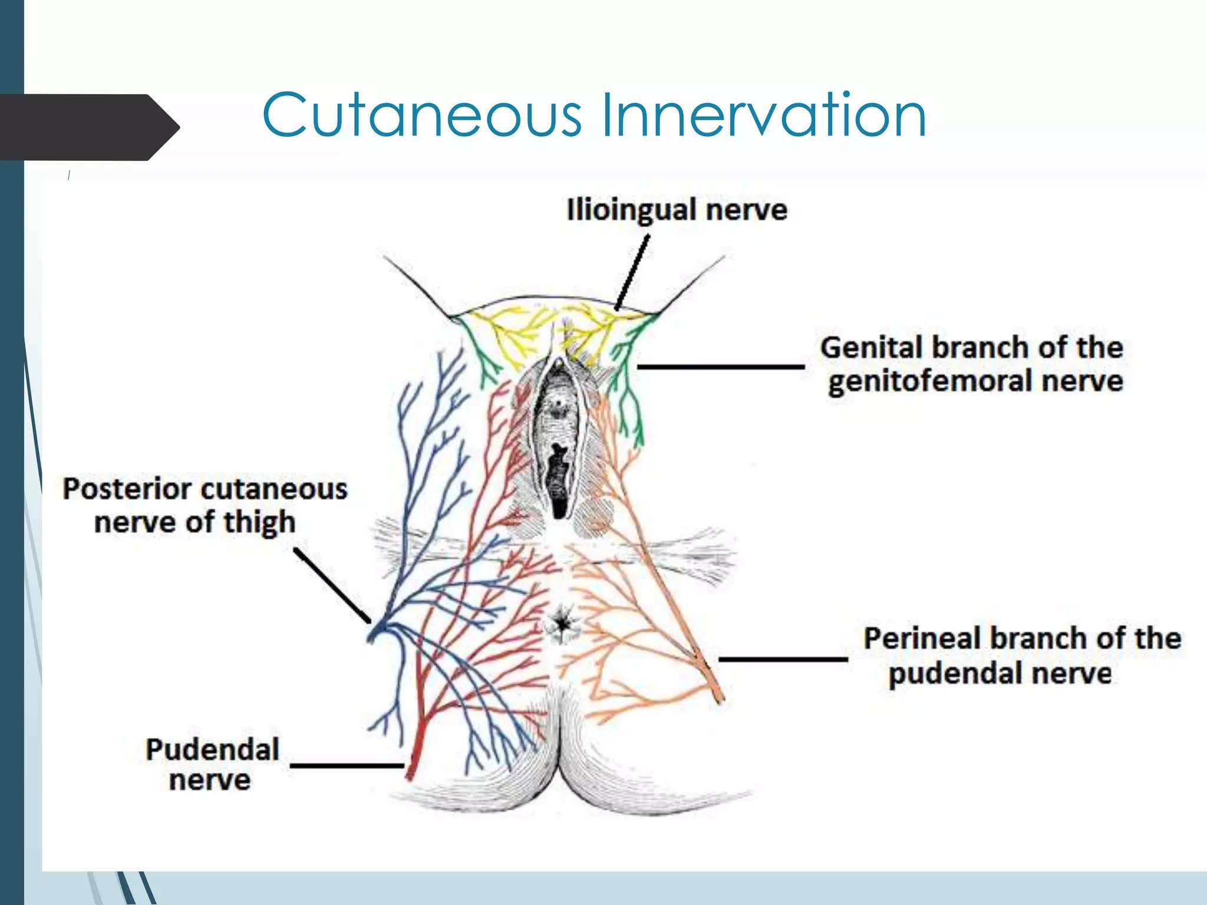

Slide 32
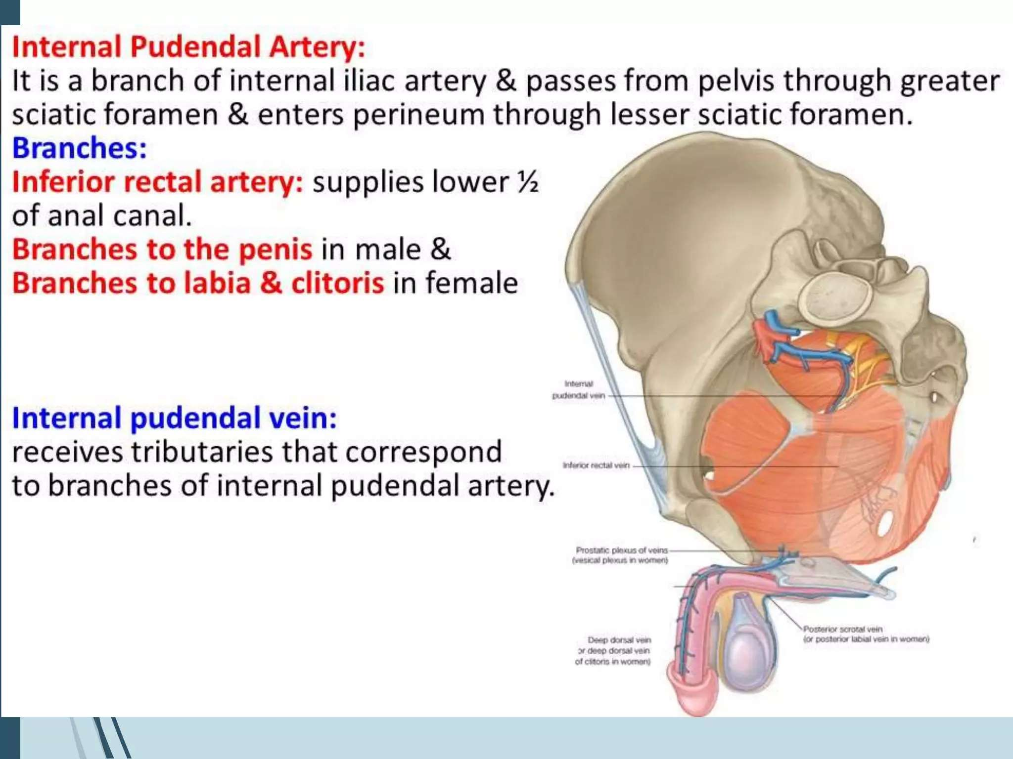

Slide 33
Function of the urogenital triangle
Supports external genitalia
Maintain urinary continence
Assist in sexual function
Provides structural support to pelvic organs

Slide 34
Clinical importance
Urethral injury and urine extravasation
Episiotomy (female)
Perineal trauma
Pudendal nerve block
Infections of the perineal spaces

Slide 35
THANK YOU

Slide 36
Male urogenital system

Slide 37
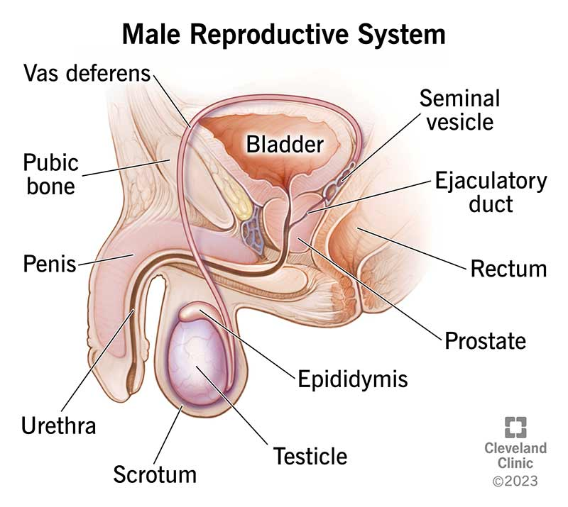
Male urogenital system

Slide 38
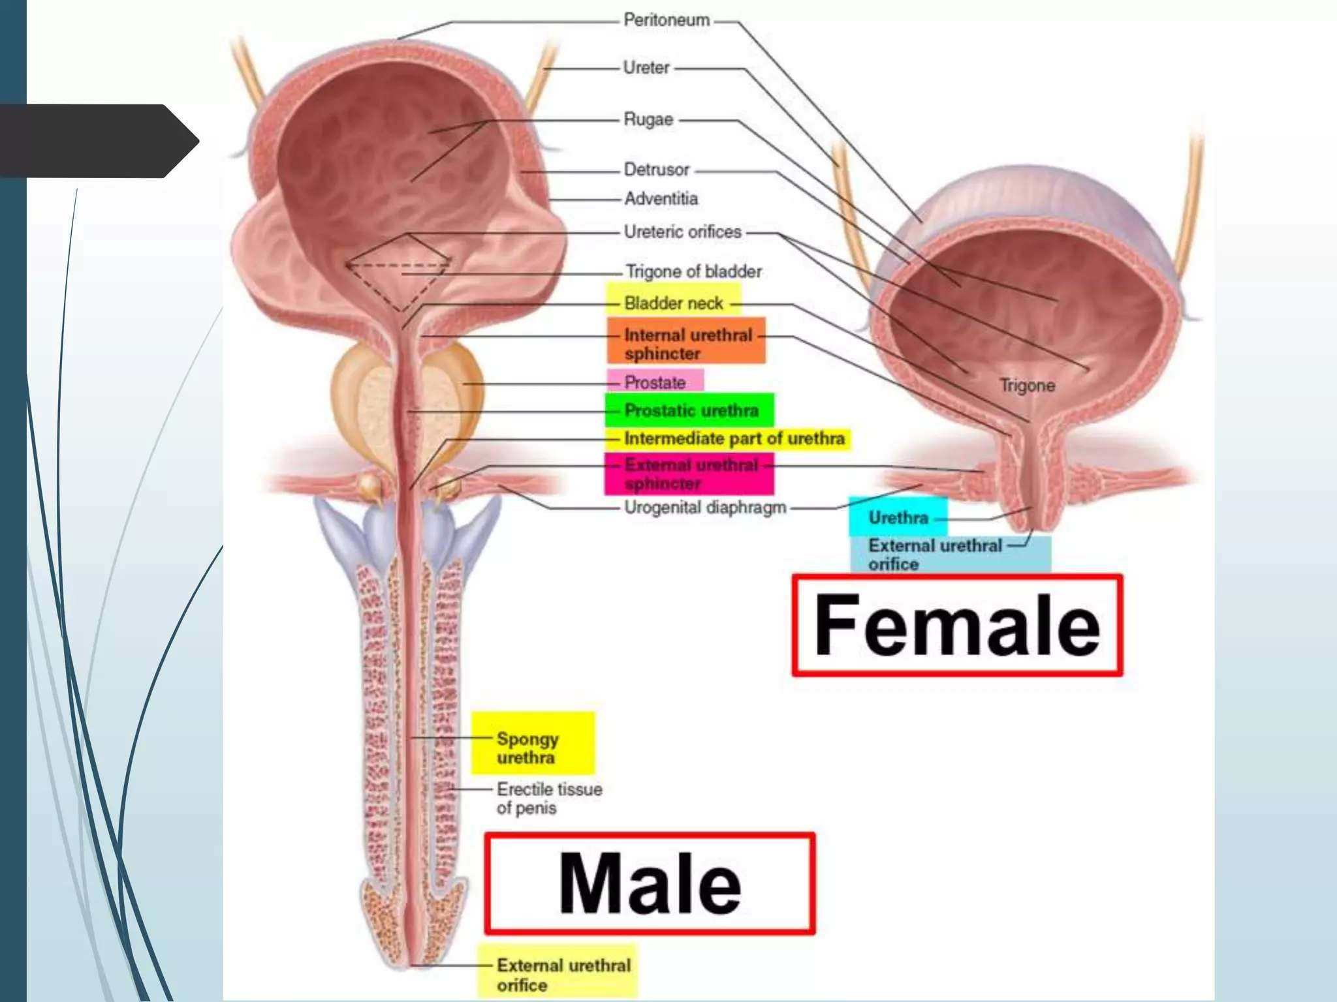

Slide 39
Male urethra
It extends from the internal urethral orifice in the bladder to the external urethral orifice at the tip of the meatus
Roughly S-shaped
Length varies from 17.5cm to 20cm
Urethral is divided into:
  Pre-prostatic urethra (0.5-1.5)- intramural segment extending from the bladder neck to the prostate
  Prostatic urethra (3-4cm)- passes through the prostate gland, receiving the ejaculatory duct
  Membranous urethra (1-2cm)-the shortest, narrowest and least distensiblepart passing through the urogenital diaphragm and surrounded by the external sphincter
  Penile urethra (15cm). The longest part is enclosed within the corpus spongiosum, which is further divided into the bulbar and pendulous part

Slide 40
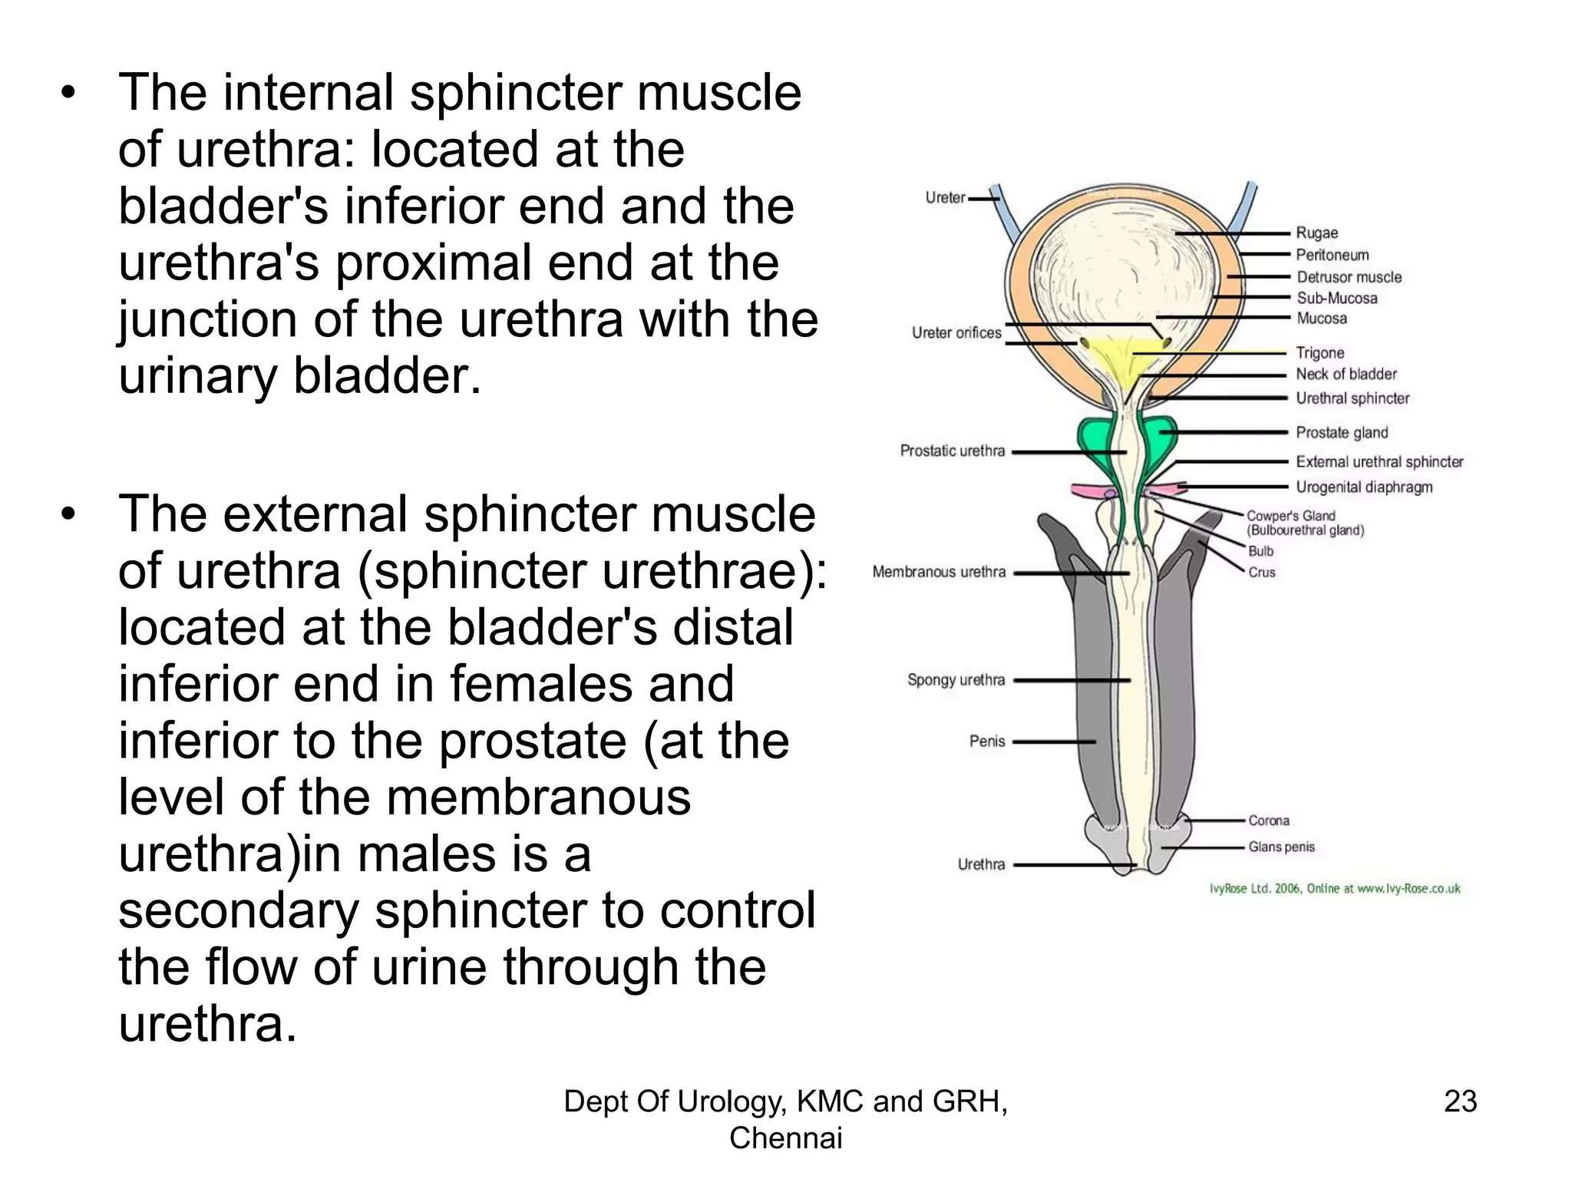

Slide 41
Blood supply of the male urethra
The arterial supply of the urethra is primarily from the bulbar arteries, which are proximal branches of the internal pudendal artery
Distally, it is supplied by the dorsal artery of the penis, which is a terminal branch of the internal pudendal artery and collateral from the corporal bodies
This dual supply allows the urethra to be detached at either end without compromise to its viability, a fact frequently used during urethroplasty

Slide 42
Female urogenital system

Slide 43
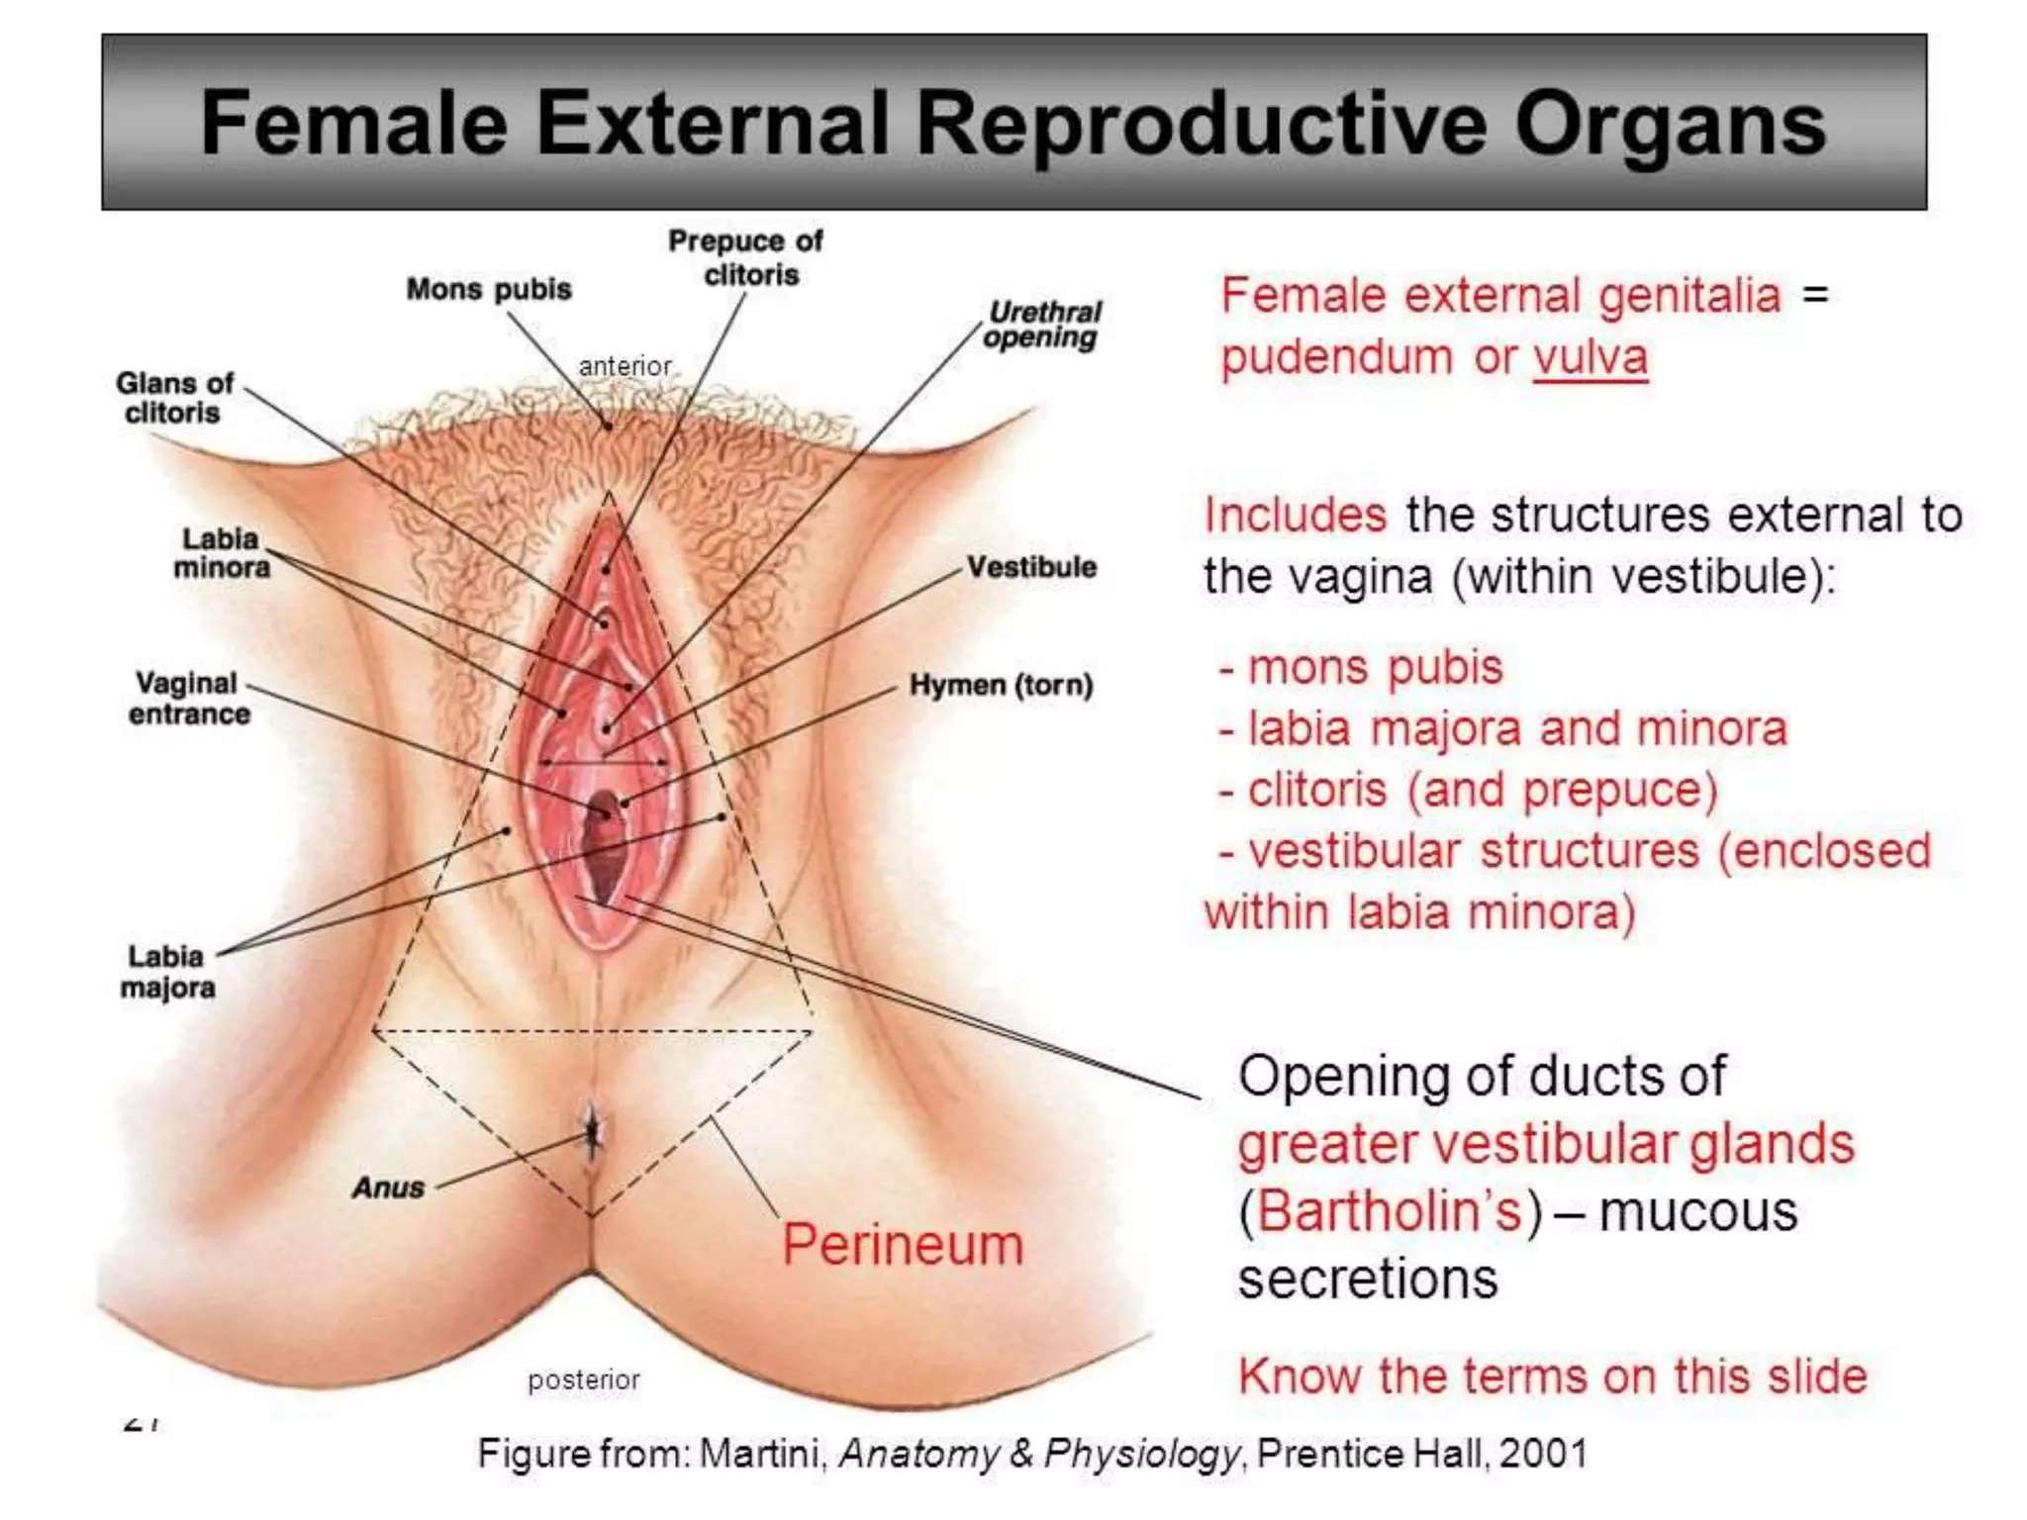

Slide 44
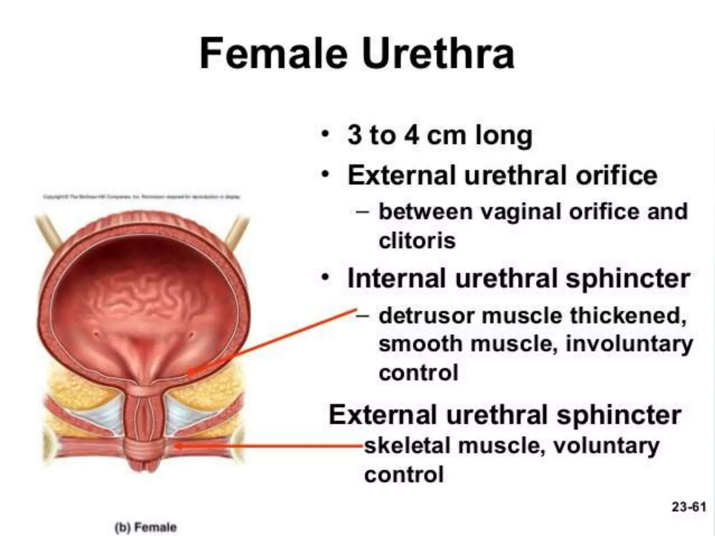

Slide 45
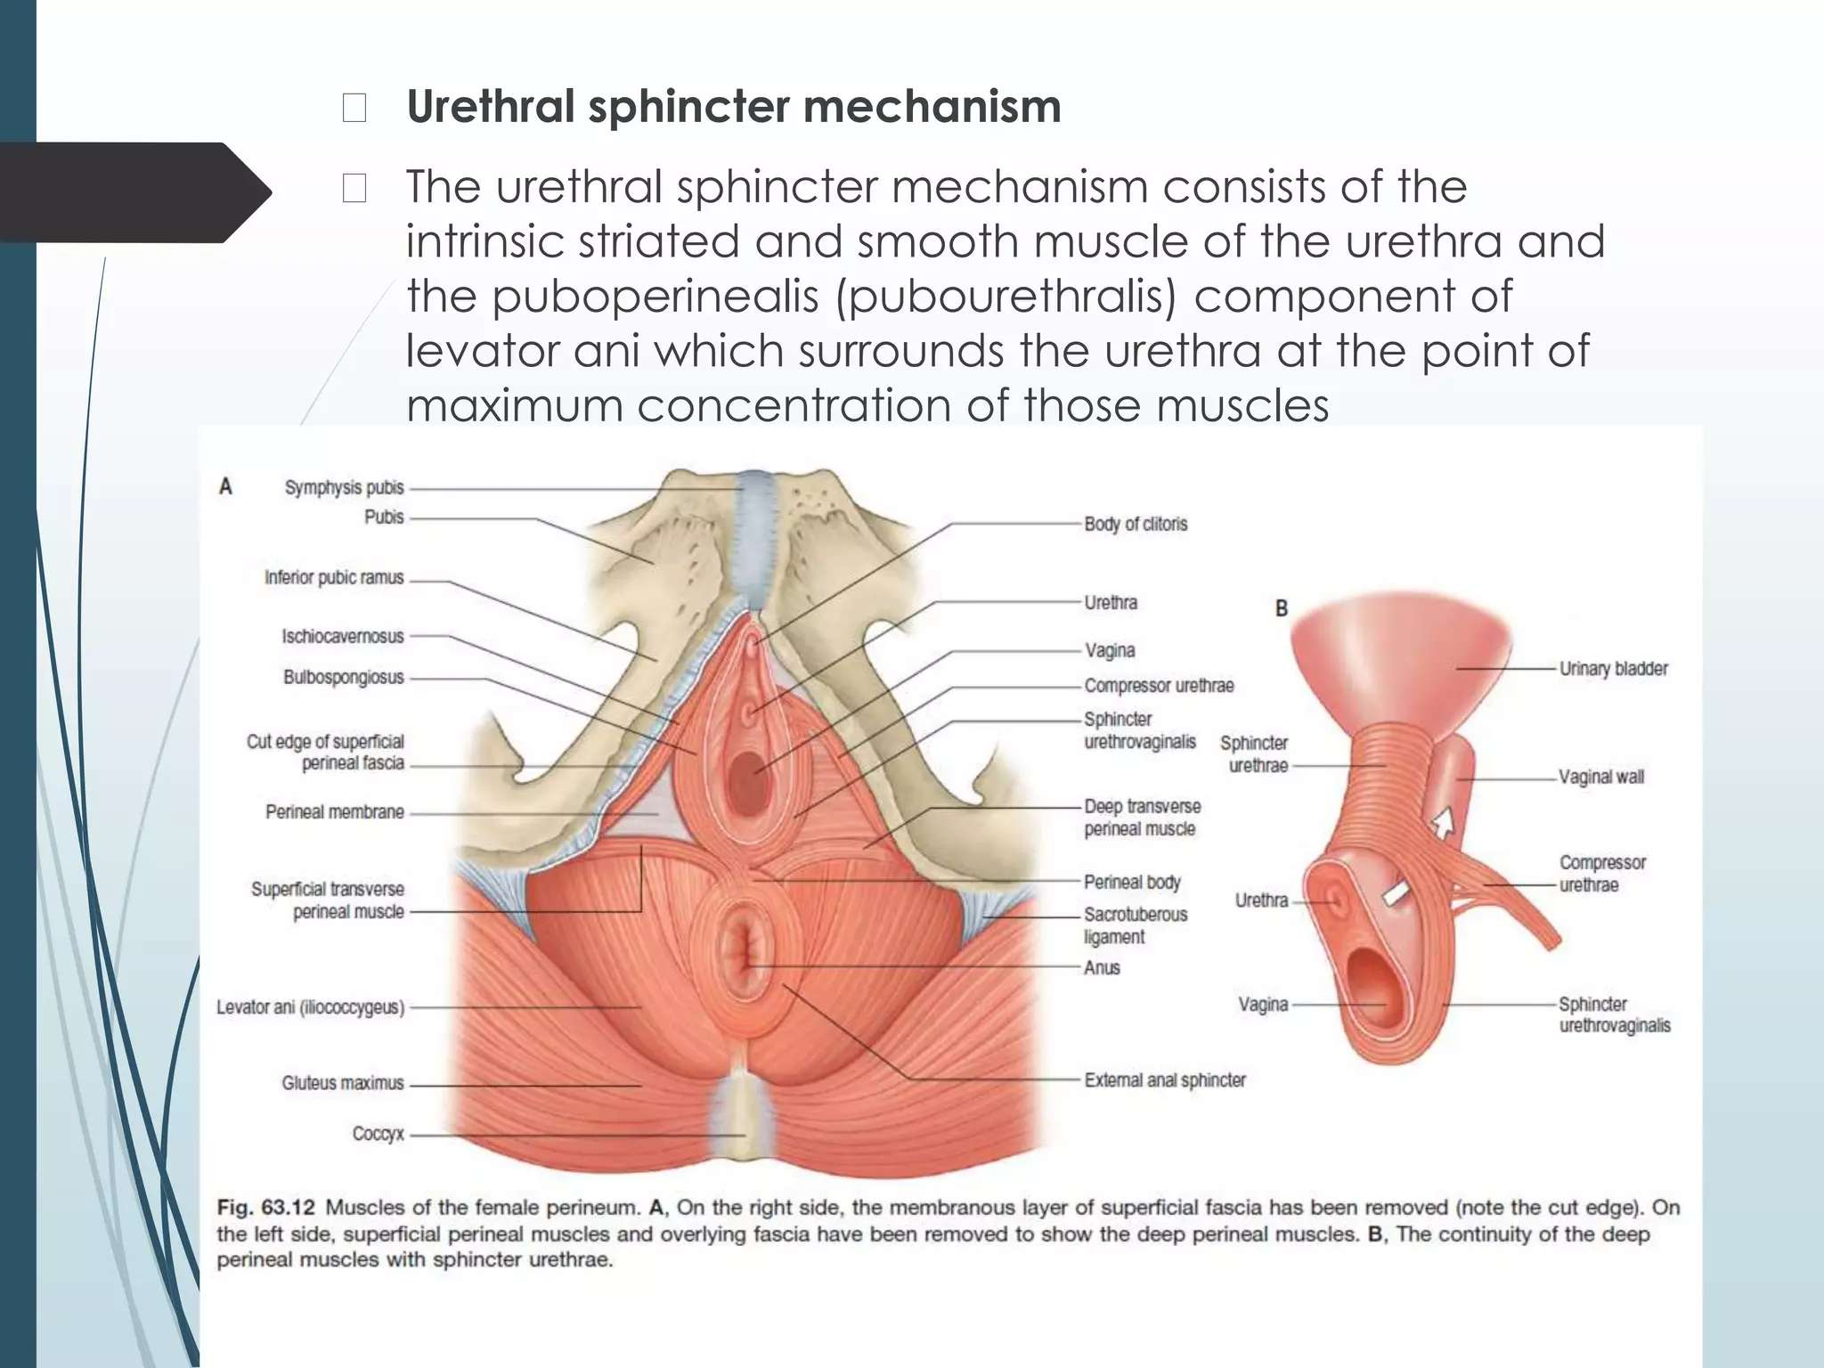

Slide 46
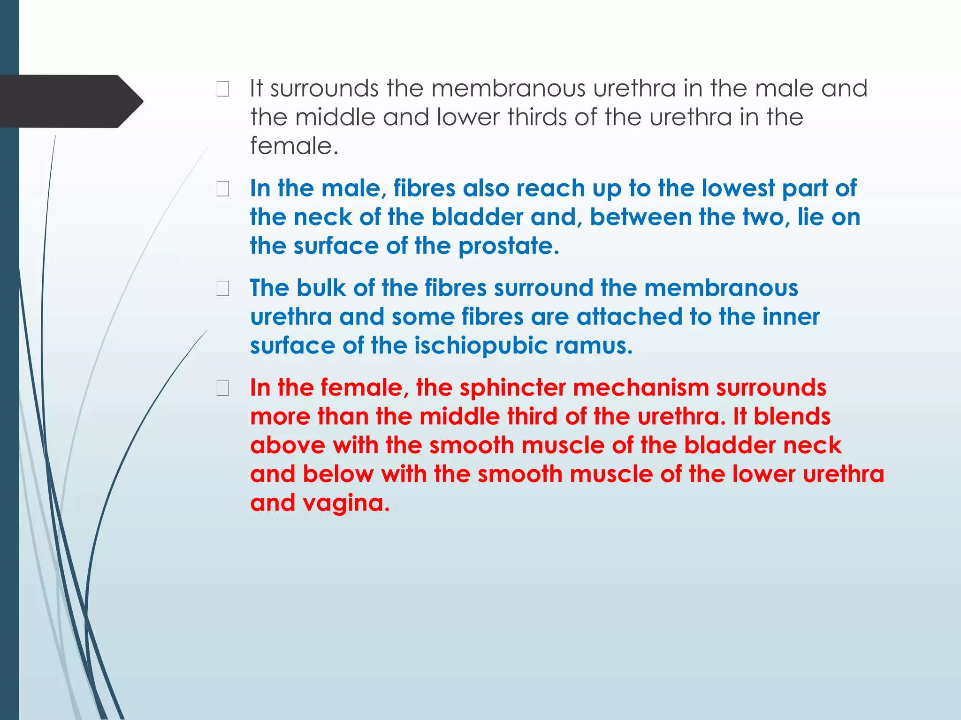

Slide 47
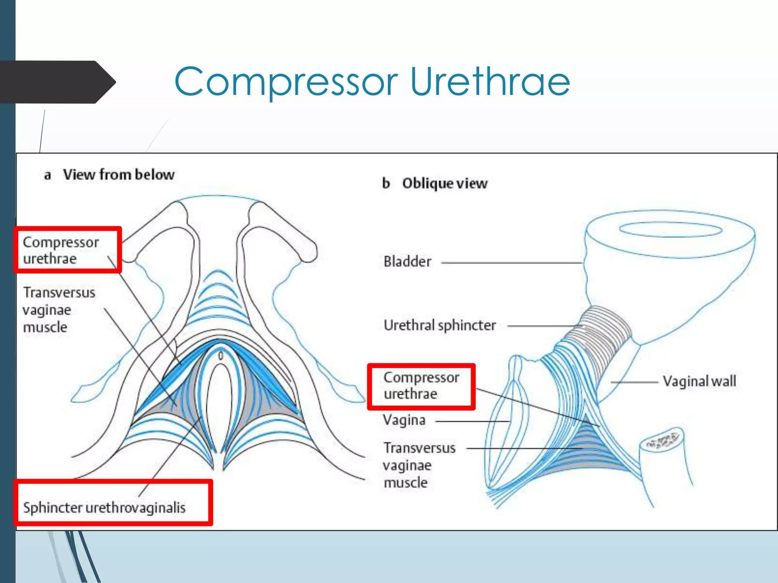

Slide 48
THANK YOU

